Slide 1
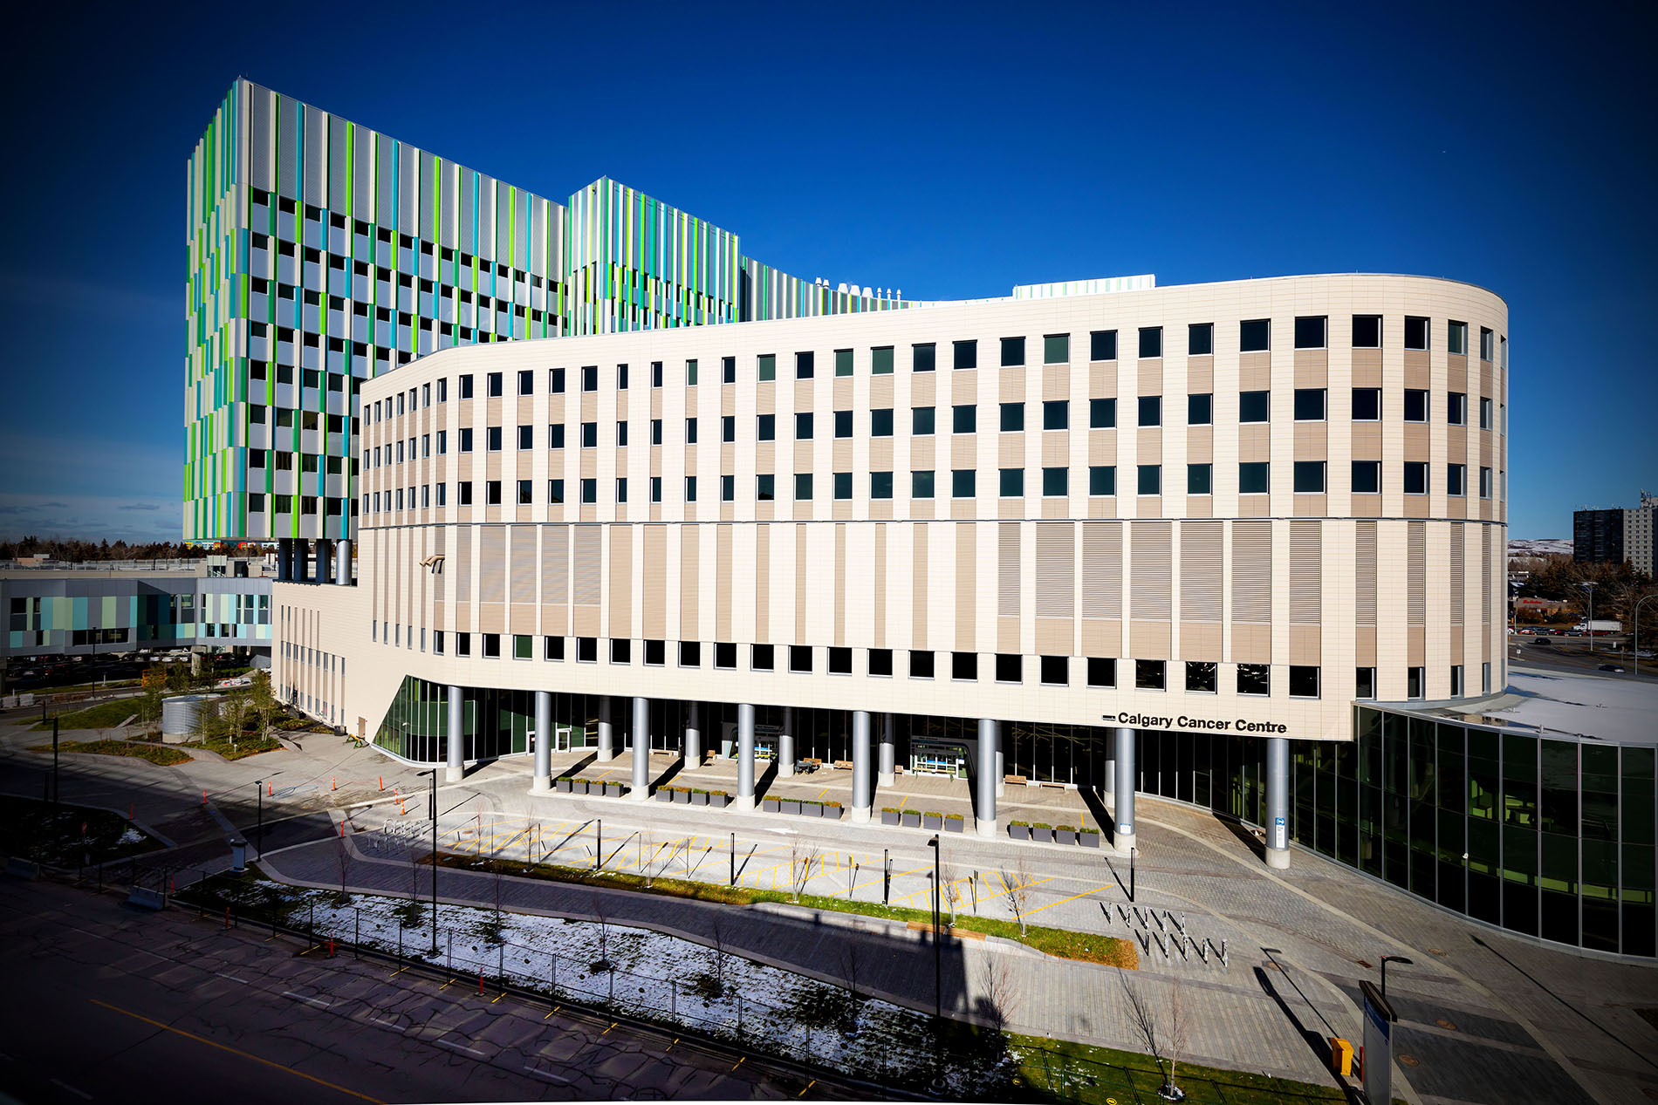
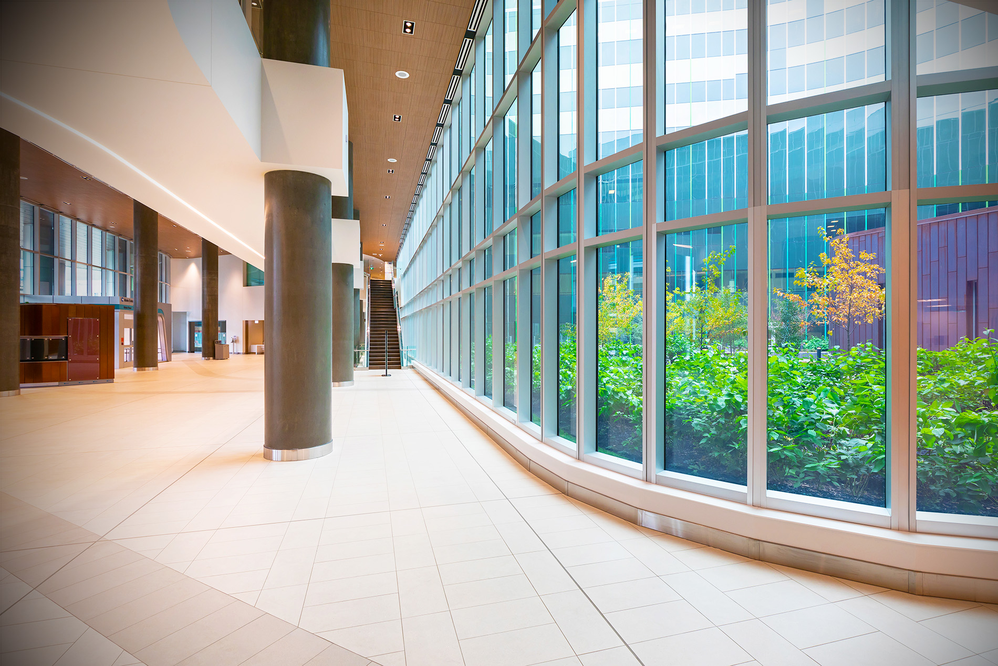
University of Calgary Radiation Oncology Residency Program
Jordan Stosky MD FRCPC DABR
Radiation Oncology Residency Program Director
jordan.stosky@ahs.ca
Natalie Logie MD FRCPC DABR
Radiation Oncology Associate Residency Program Director
natalie.logie@ahs.ca
January 30, 2024
Notes:
Welcome everyone. My name is Shaun Loewen and I’m the program director for the University of Calgary Radiation Oncology Training Program. I’m joined by two our Radiation Oncology residents, Dr. Amanda Khan, Chief Resident in her 3rd year of training, and Dr. Conrad Bayley, a 1st year resident in our program. Today, we’re going to explore what a career in Radiation Oncology looks like.

Slide 2
Welcome
U of C Radiation Oncology Training Program
Arthur J.E. Child Comprehensive Cancer Centre Update
Notes:
The session today will be broken down into 5 sections. We’ll start with an overview of the Speciality of Radiation oncology, then talk specifically our training program in Calgary. Following, we’ll highlight some CaRMS and workforce trends in this specialty and provide you with some information about income and the job market. Then, our two residents will share their perspectives, and we’ll end the session with an opportunity to answer your questions.

Slide 3
Training Program Highlights
U of C Radiation Oncology Residency Program established in 2002
26 graduates
6 more currently in training
5-year residency training; direct entry via CaRMS Match
100% success rate at Royal College exams

Slide 4
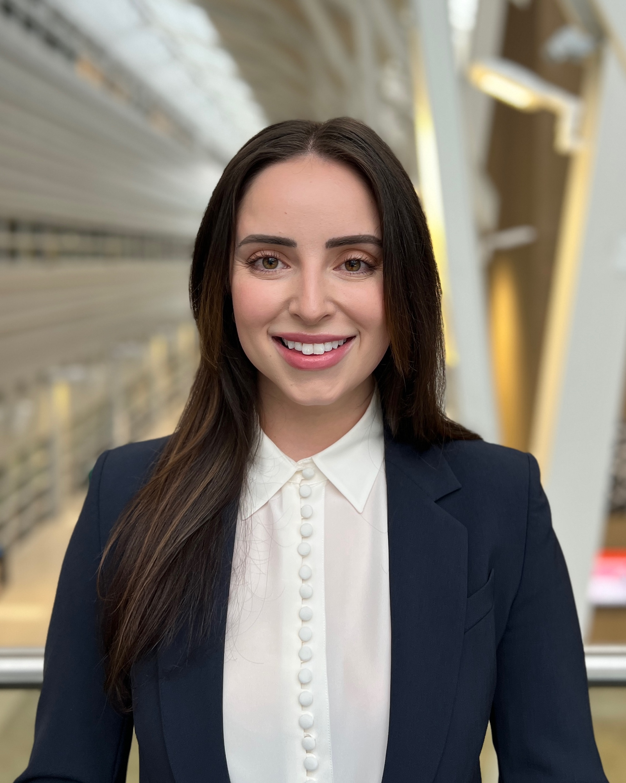
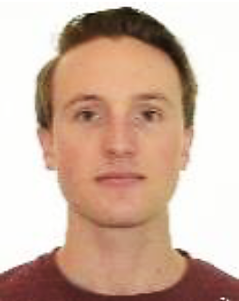
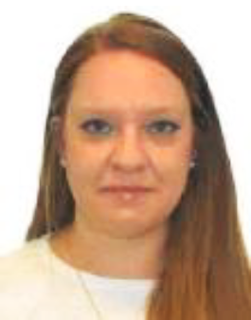
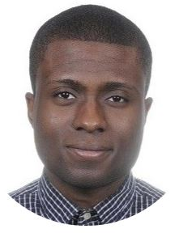
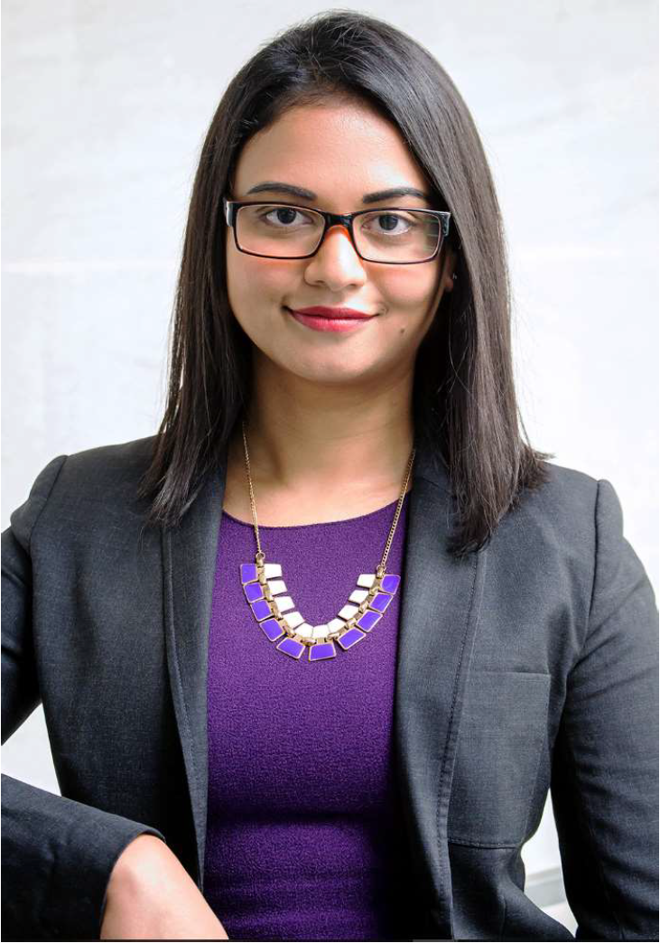
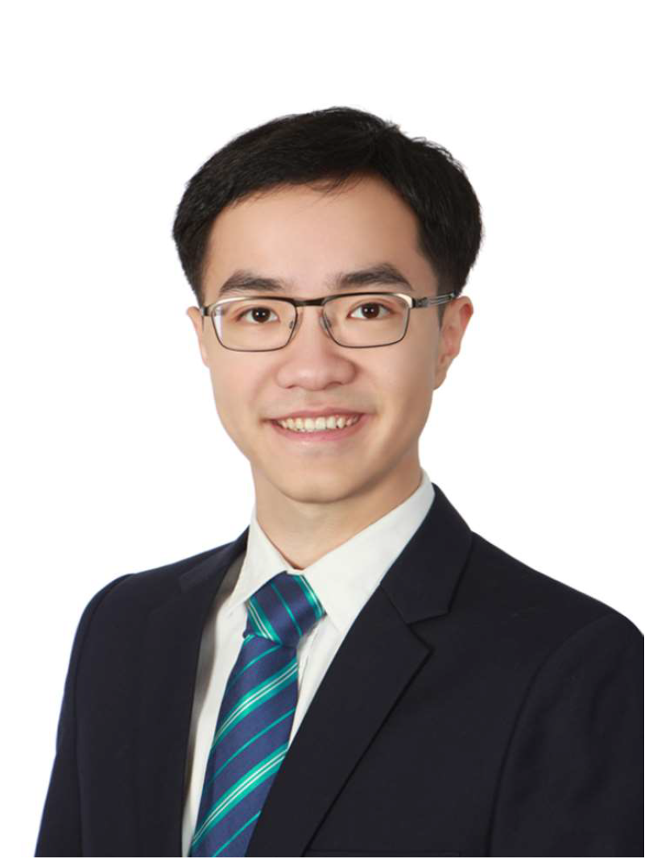
Current Residents
Dr Catherine Stewart
PGY1
Dr Conrad Bayley
PGY2
Dr Allison Rau
PGY2
Dr Daniel Davies
PGY3
Dr Amanda Khan
PGY3
Dr Steven Xu
PGY4

Slide 5
Graduate Employment
Former graduates employed in Alberta (10), Saskatchewan (2), BC (5), Ontario (3), Saudi Arabia (1) and USA (4)

Slide 6
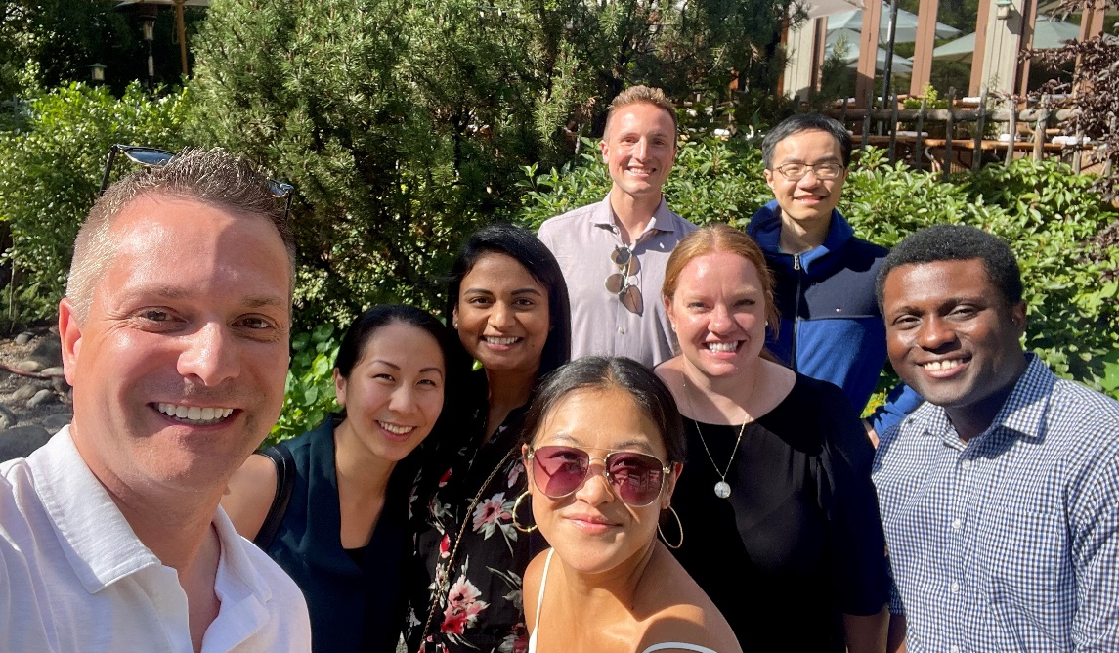
Social Activities
Escape Room

Slide 7
Recent Program Initiatives
Competency By Design (CBD) program launched in July 2019
Secured $116,900 over 7 years for CBD program development, simulation-based education development, and infrastructure development
1 of 3 accredited Royal College Area of Focused Competence (AFC) programs in Brachytherapy
Hosted RO Exam Prep Course in 2019/20 and 2022/23

Slide 8
EPA Breakdown per Stage
Transition to Practice | EPA 1 Professional development and personal wellness plan |  | EPA 2 Assess/manage cancer patients at a consultant level |  | EPA 3 Manage day-to-day aspects of practice |  | EPA 4 Complete a scholarly project
Core | EPA 1 Initial patient assessment | EPA 2 Develop/ communicate a management plan |  | EPA 3 Radiation treatment planning | EPA 4 On-treatment management | EPA 5 Follow-up plan |  | EPA 6 Teaching/ propagating RO knowledge
Foundations | EPA 1 Manage common medical/surgical problems |  | EPA 2 Identifying learning needs and address knowledge gaps |  | EPA 3 Manage medical error/adverse event |  | EPA 4 Assess/manage cancer patients in various settings
Transition to Discipline | EPA 1 History and Physical Exam |  |  |  | EPA 2 Patient Handover

Slide 9
Radiation Oncology CBD Roadmap
Certification (51 – 65 months, including exam) 4 years, 3 months – 5 years, 5 months
Transition to Practice (3-9 months)
Core (36-44 months) Includes electives/research blocks
Foundations (11 months)
Transition to Discipline (1 month) Orientation / Assessment
Final Competency Assessment
Exam in late PGY4/early PGY5
EXAM
ePortfolio multi-faceted assessment

Slide 10
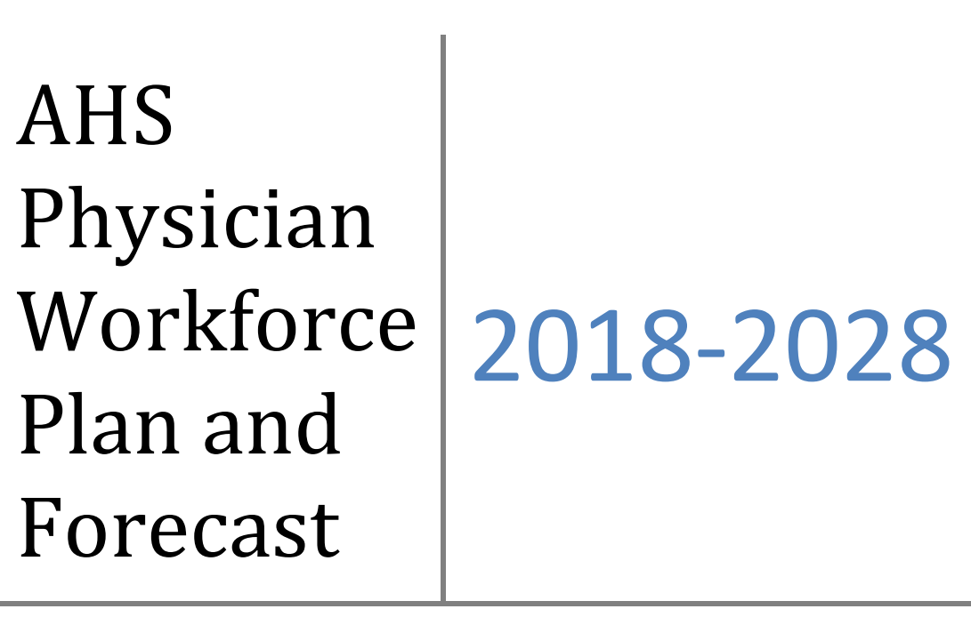
Employment Outlook in Alberta
Workforce need is ~3-4 FTE per year for the next few years

Slide 11
Arthur J.E. Child Comprehensive Cancer Centre
Scheduled for open October 2024
Will consolidate 2 training locations into 1 (previously some clinics downtown at Holy Cross site)
Two MR-LINACS
New MR-Simulator
New PET-CT Simulator
Two MR-Guided brachytherapy suites

Slide 12
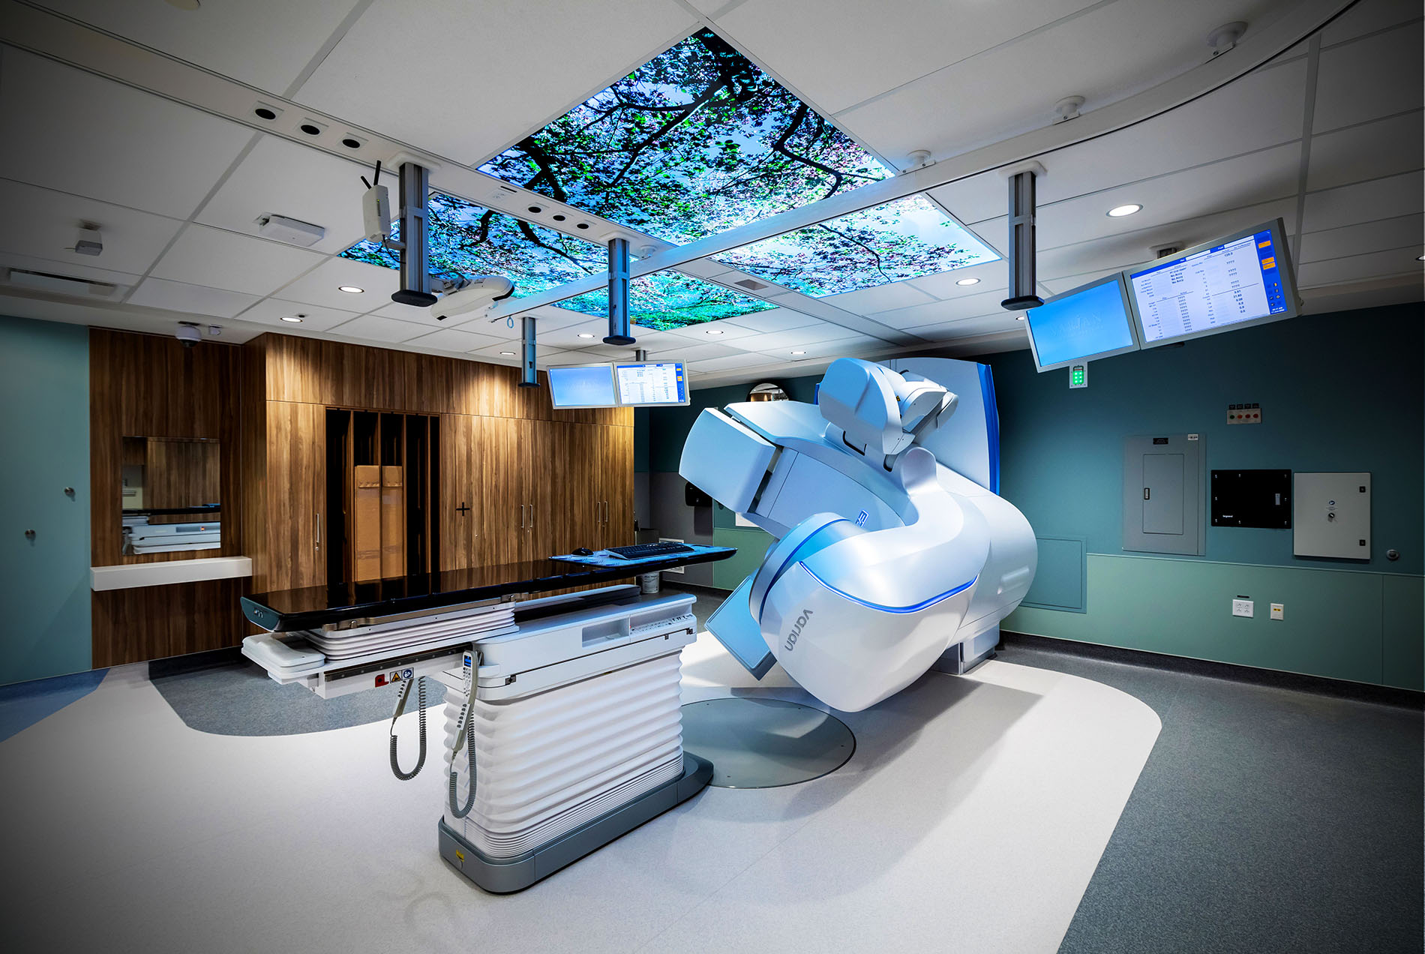
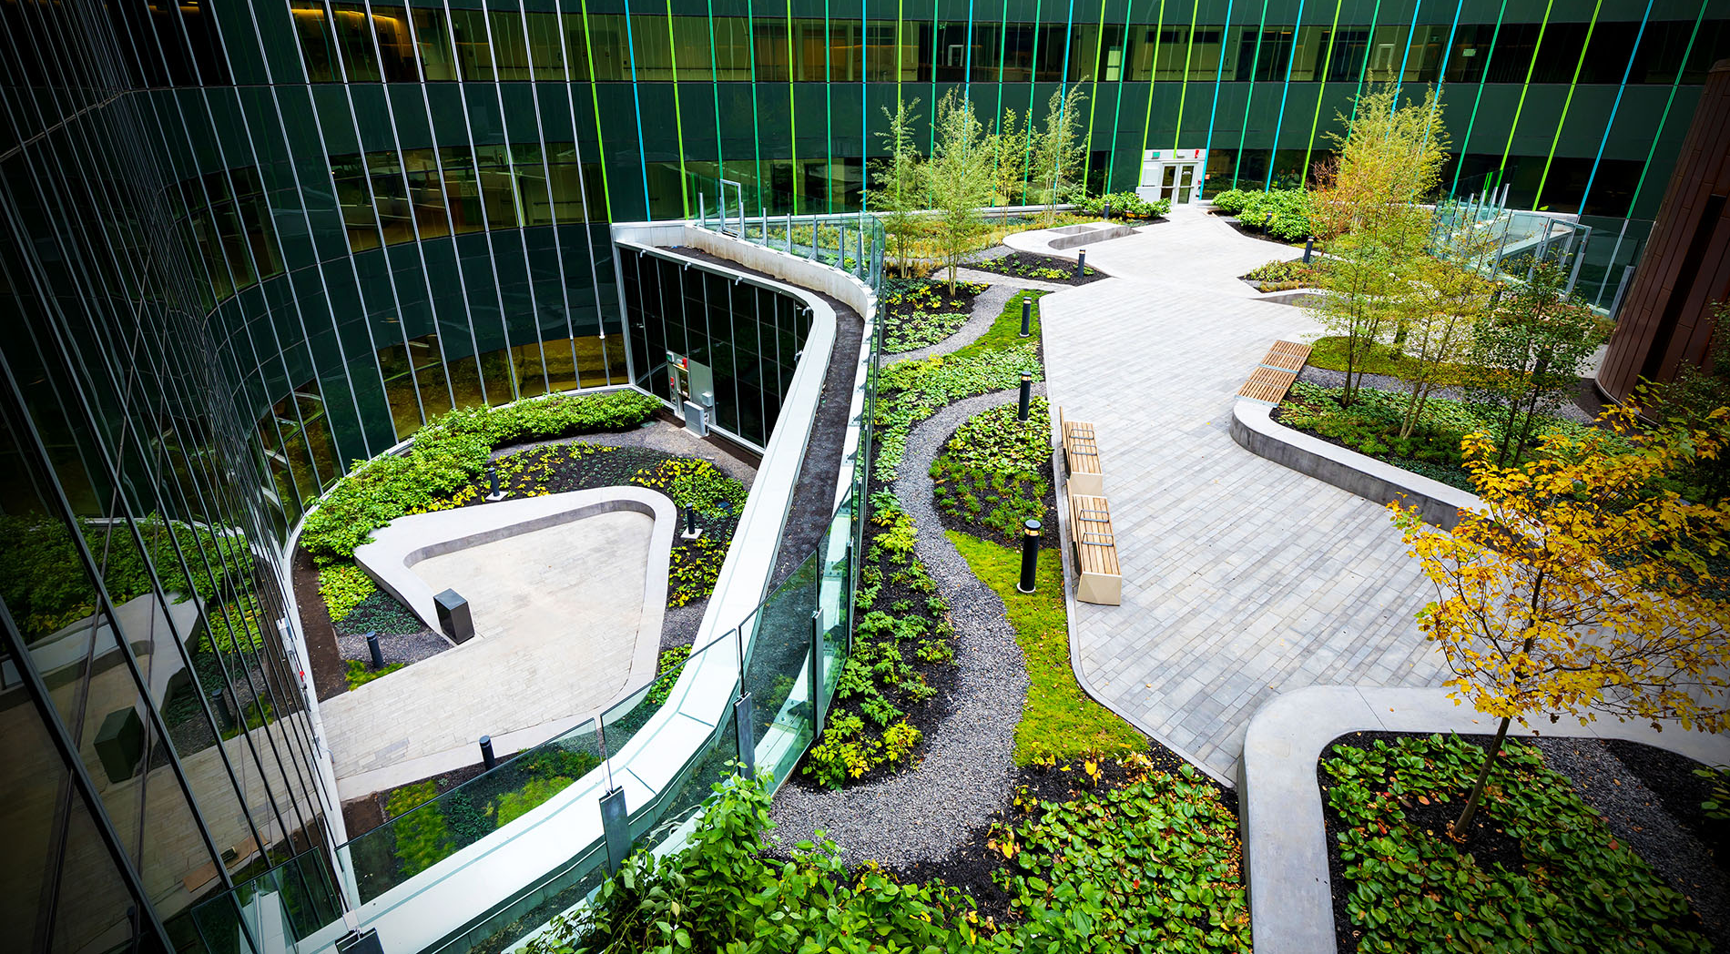

Slide 13
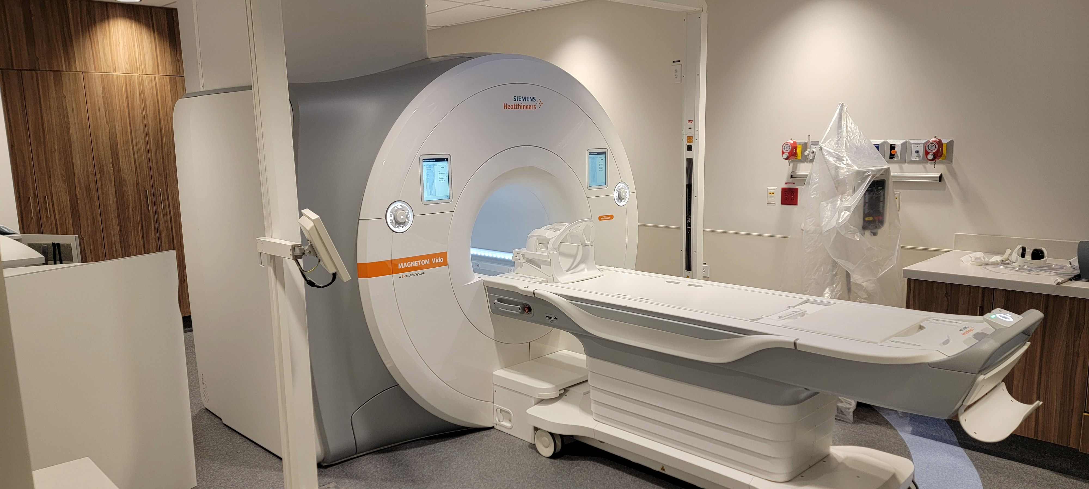
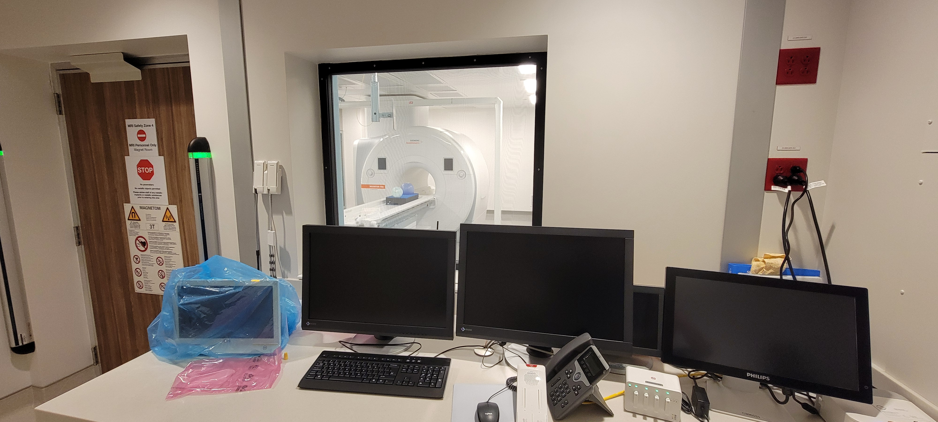
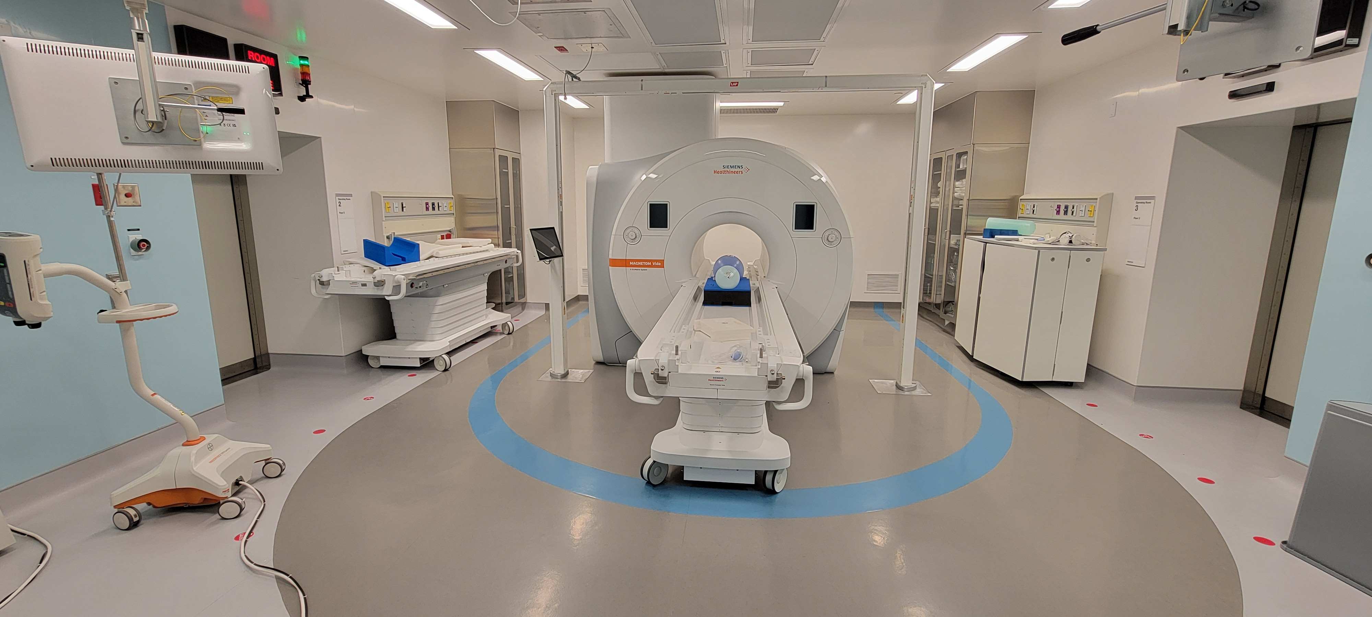
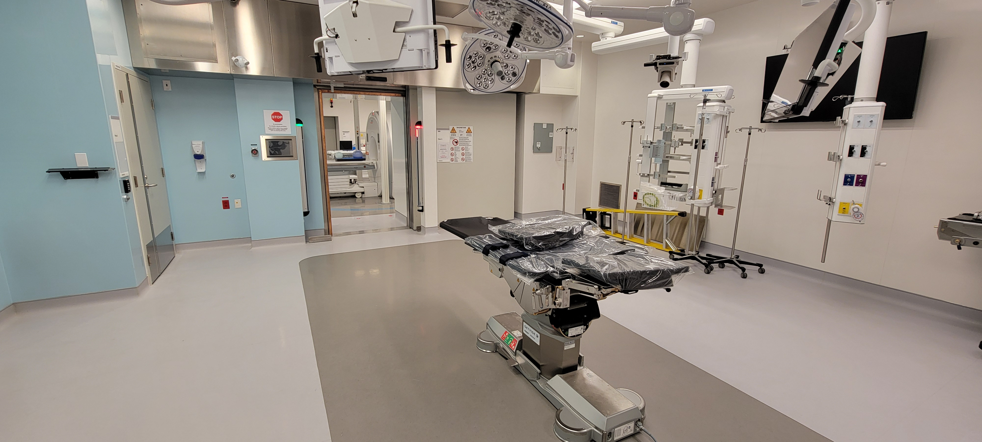

Slide 14
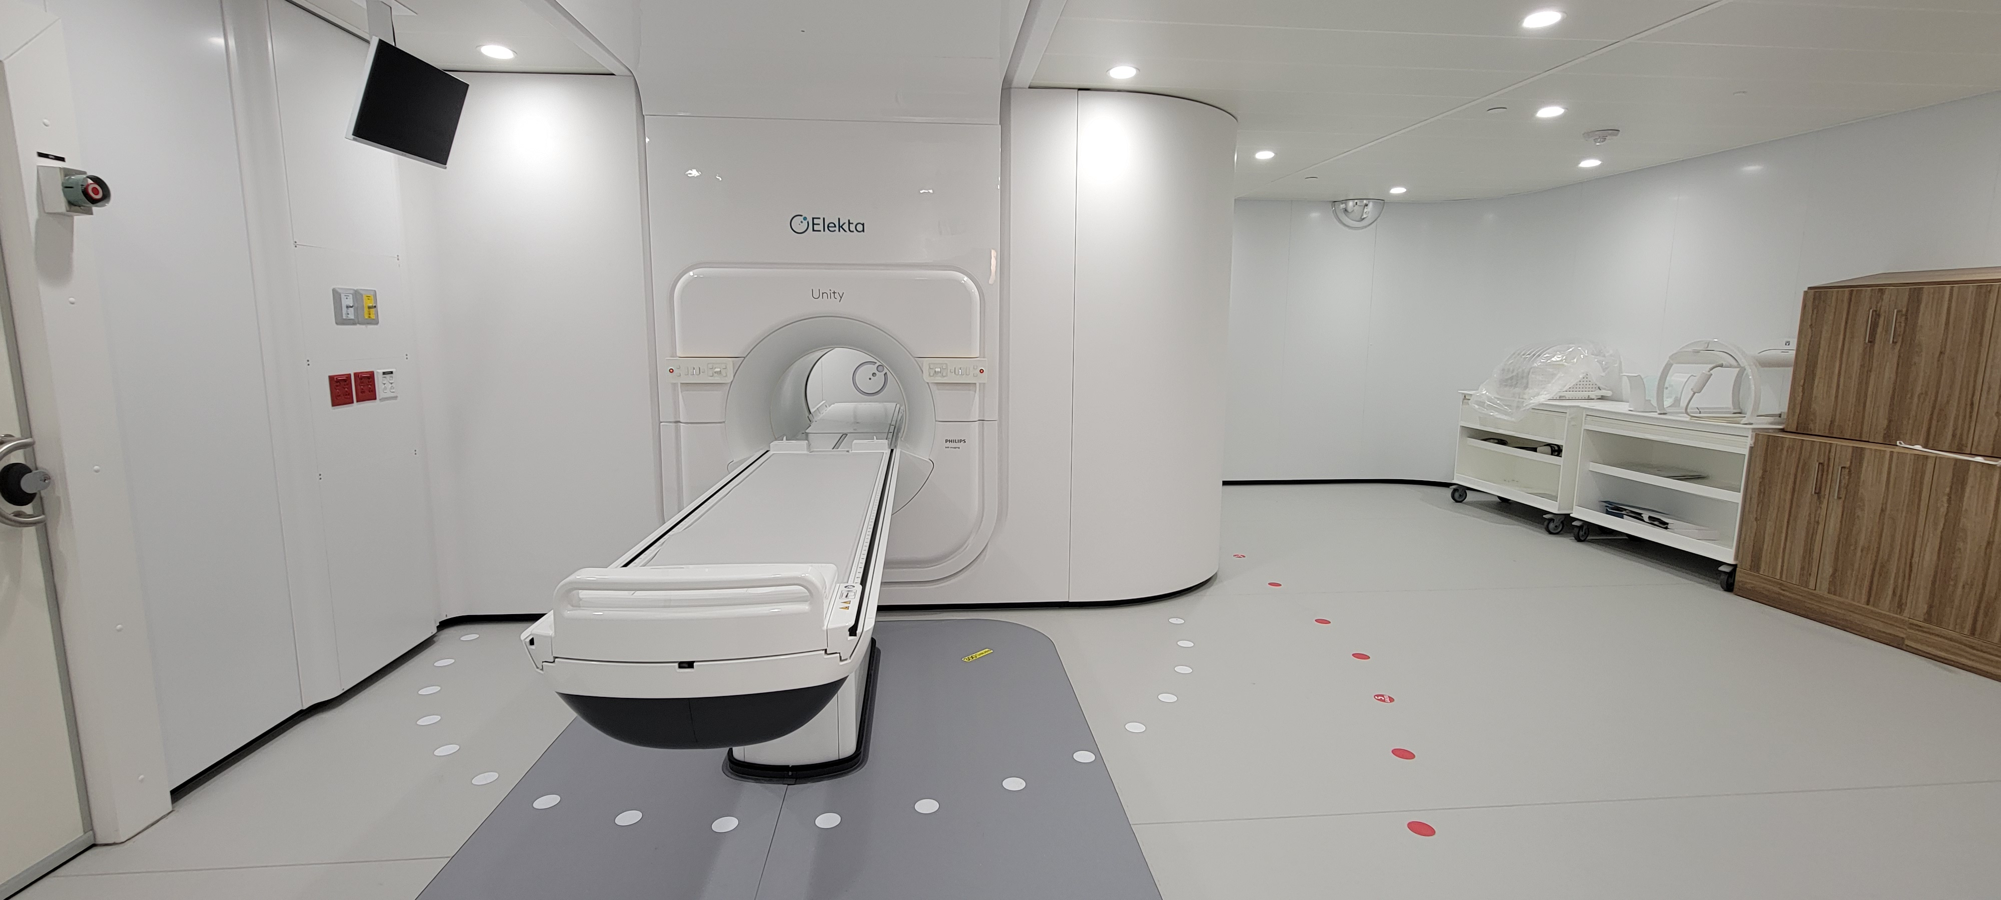

Slide 15
Questions? jordan.stosky@ahs.ca natalie.logie@ahs.ca melissa.watkins2@ahs.ca

