Slide 1
To Fast Forward or not to Fast Forward, or: How I learned to love 1 week of radiotherapy without SLNB
Radiation Oncology Breast Research Day
December 16, 2020
Dr Jordan Stosky, MD, FRCPC
Notes:
Actually the how I learned reference is Dr Strangelove, but hamlet also seemed appropriate

Slide 2
Objectives
Review natural history of women undergoing breast excision who do not have sentinel lymph node biopsy
Estimate relative risk of ultrahypofractionation to the breast in absence of sentinel lymph node biopsy
Estimate relative competing risk of nosocomial COVID-19 transmission with additional 2 weeks of XRT
Discuss relative risks of above

Slide 3
The ‘Choosing Wisely Population’
Society of Surgical Oncology in 2016 released their Choosing Wisely guideline
“Don’t routinely use sentinel node biopsy in clinically node negative women ≥70 years of age with early stage hormone receptor positive, HER2 negative invasive breast cancer”
Endocrine therapy is standard for all patients with hormone receptor positive disease. The omission of sentinel lymph node biopsy in clinically node negative women ≥70 years of age treated with endocrine therapy does not result in increased rates of locoregional recurrence and does not impact breast cancer mortality. Patients ≥ 70 years of age with early stage hormone receptor positive, HER2 negative breast cancer and no palpable axillary lymph nodes can be safely treated without axillary staging. Axillary staging can be individually considered, if the results may impact radiation recommendations and systemic therapy decisions.

Slide 4
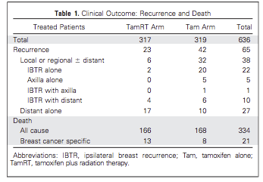
Sources for statement
Long term followup of CALGB9343

Slide 5
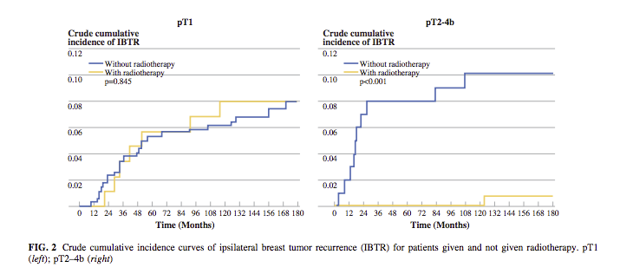
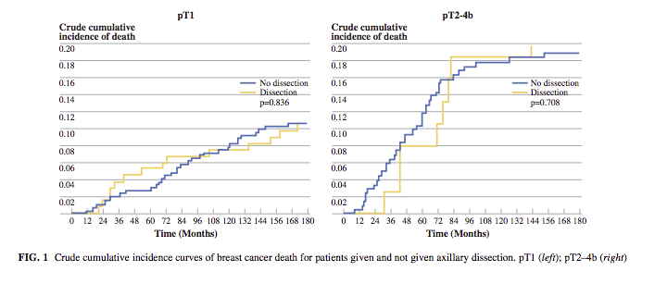
Sources for statement
Axillary dissection versus no axillary dissection in elderly patients with breast cancer and no palpable axillary nodes: results after 15 years of follow-up, Martelli G et al, 2011
RT was given to breast alone at discretion of rad onc, not axilla

Slide 6
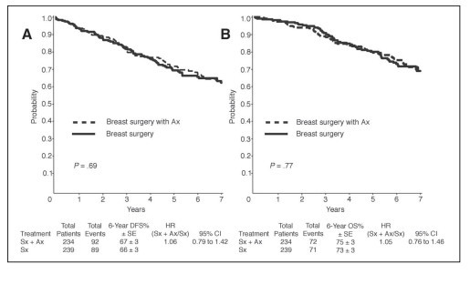
Sources for statement
Randomized trial comparing axillary clearance versus no axillary clearance in older patients with breast cancer: first results of International Breast Cancer Study Group Trial 10-93, Rudenstam CM et al
Left: DFS
Right: OS

Slide 7
Sources for statement
Not performing a sentinel node biopsy for older patients with early-stage invasive breast cancer, Chung et al
140 patients treated with BCS without SLNB
98% no chemo
76% no RT
41% no endocrine therapy
MFU 4.5 years
Median age 83 years
T1 74%
Events
1 axillary recurrence (trip negative)
OS5 70%; BCSS5 96%
Most frequent cause of death: ischemic heart disease

Slide 8
What affects outcomes?

Slide 9
Outcomes (Big picture)
Volumes
Biology
Doses

Slide 10
Volumes
Same with 16 fr and 5 fr – no concern of ‘missing’ the target
Not treating the axilla in either case, therefore unlikely to have difference in this comparison

Slide 11
Biology
These patients are inherently ‘low risk’ by age, tumor criteria, markers, and we should ensure that if we apply UK FF TO these patients who have SLNB omitted, that they continue to fit within this paradigm
Notably, highest relapses in triple negative population, as one might expect

Slide 12
Doses
No direct evidence, but few noninferiority trials that show relatively similar outcomes at 5 years with APBI/ultra hypofrac compared to moderate hypofrac
IMPORT LOW
UK FF
B39 (APBI)
With inductive reasoning, recurrence rates probably in keeping with APBI volume, and not dose, as we can see from IMPORT LOW
Long term followup shows <1% difference in 10 year IBTR compared with WBRT
38.5 Gy/10 BID over 5 days, 34 Gy brachy
Livi – 30 Gy/5
Comparable to WBI
Historically speaking, with longer followup recurrences trend linearly and have not deviated from that trend past 5 years

Slide 13
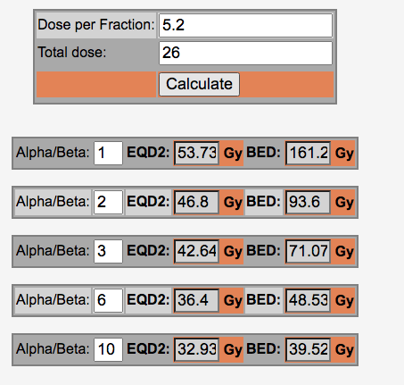
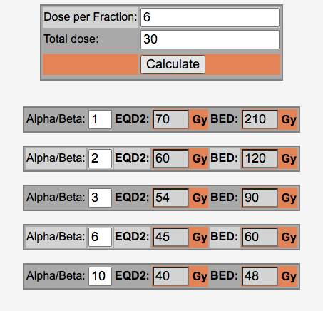
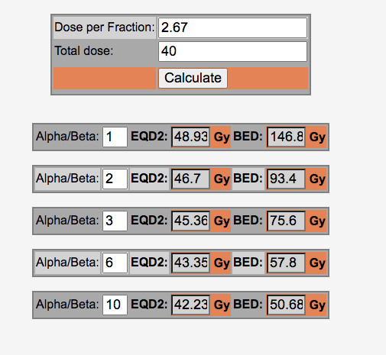
Doses (cont.)
Notable points:
30Gy/5 higher than 26/Gy in 5, but 26Gy comparable to 40 Gy at low a/b ratios
No increased IBTR with 27 compared to 26 Gy, so probably higher flat on the NTCP curve
Pre-test probability of dose playing a significant role compared to moderate hypofractionation, given the 5y UKFF, is low

Slide 14
Other pertinent questions

Slide 15
What is the chance that there is (untreated) pN1 disease in the choosing wisely population?
Predicting Nodal Positivity in Women 70 years of age and older with hormone receptor-positive breast cancer to aid incorporation of a socity of surgical oncology choosing wisely guideline into clinical practice, Welsh et al 2017
NCDB 2010-2013 analysis of 71834 cases
pN+ rates of HR+ cN0 breast cancer = 15%
G1, cT1mi-T1c, or G2 cT1mi-T1b = 7.8%

Slide 16
What is the chance that RT would impact occult pN+?
Hard to find data to describe impact of RT in pN+ in patients without chemotherapy… Jeff?
Probably this will become more common in younger population now after SA 2020…
Z11 >95% had adjuvant chemo
AMAROS >60% had chemotherapy
MA-20 >90% had chemo
pN+ with chemo + RT – 5% DFS at 10 year difference we know from MA20 if we cover axilla.
Likely this represents the upper bound of RT effect in occult nodal disease covered by tangents

Slide 17
What is the estimated absolute rate of women that might be harmed with unidentified pN1 with ineffective RT?
5% * 15% = ~0.75% at a high bound

Slide 18
What about COVID-19?
Estimated infection fatality rates for 70-80 year olds
4-5%
80+
8%
Fatalities will generally occur within 1 month of infection
Notes:
Ontario public health data 2020

Slide 19
Estimated risk of transmission with RT appointments?
Very hard number to estimate. Rare.
Increases with increasing community prevalence
Decreases with increased PPE, department physical distancing, etc

Slide 20
Estimating nosocomial COVID-19 risk
Inpatient setting – 12% transmission in UK
This represents a high bound
Outpatient presumably is significantly less
Assume 4000 new starts/year, high covid prevalence past 2 months, and 200 patients >70 years of age in past two months
Statistics dictate that ~1/3 of having seen one event if transmission rate per course of RT is <=1%
Low, also signifies somewhat of an upper bound of risk estimate
Rates are not truly independent of each other, but reasonable to estimate a 3 week course has 3x of risk compared to a 1 week course of treatment, or 2x additional absolute risk

Slide 21
Estimating nosocomial COVID-19 risk (cont.)
Without an effective risk estimate, but have relative risk estimates, one approach is making the assumption of equivalent frequencies, and performing a sanity check
It gives us a basis for what is ‘higher’ risk if we find an invalid answer

Slide 22
Comparing relative risks
If we assume the 10 year rate of differential harm with UK FF (0.5%-0.75%), let’s pick 0.75% for ease of calculation, then the chance of fatal COVID per week of RT treatment would be 0.25% with 3 weeks of XRT
This implies a COVID infection rate of 0.1% with a IFR of 0.05 (0.0025/0.05 = 0.05%/week*2 additional weeks = 0.1%)
This is in keeping with a crude estimate of <1%

Slide 23
Sensitivity analysis – is this over or underestimating?
Our estimates were internally valid. How likely are we to be off by an order of magnitude?
Risk is probably not underestimated given last week’s cross sectional analysis. Probably best characterized as low risk but with high variance.
If the risk is over estimated, and the rate of iatrogenic fatality due to COVID is <0.1%, then what is the low bound of risk?
Probably between 0.05% and 0.005% absolute. Cannot assign zero risk
Then two weeks of RT confers a iatrogenic fatality rate of 0.05%

Slide 24
These are getting to be a lot of numbers…
To summarize, I estimate:
Risk of contracting fatal COVID for 70+ due to extra two weeks of RT estimated to between 0.05% and 0.5%
Risk of UK FF harming patient due to change in dose/fractionation as compared to 16 fr RT– between 0.5-0.75%

Slide 25
Comparing Hazards
Risk = Frequency * Impact
Frequencies are comparable, or within one order of magnitude
Impact of axillary nodal relapse over 10 years – moderate
Some recurrences will be salvageable
Not all recurrences fatal
Endocrine therapy available
Impact of contracting fatal COVID – very high(!)
Death within 1 month

Slide 26
Choosing one or the other
Given that frequencies are relatively comparable, but that the impact of COVID is significantly higher over a much more immediate timeframe, my judgement is that the risk of offering 2 weeks of extra XRT to those at highest risk of contracting fatal COVID, in those that are at lowest risk of relapse and breast cancer fatality, is not warranted

Slide 27
But Jordan, why can’t we just delay treatment?
Vaccines probably won’t be prevalent still for next 4-6 months… outside the window of most effective XRT
But as we get closer to, or if someone has a date for their second dose, then it becomes an option…

Slide 28
Thank you for listening to my soliloquy
Don’t forget to like and subscribe to my powerpoint channel, and check out my other videos:
Risk analysis – how to go on tangents and still have fun
Decimal points and percentages – double checking them sometimes still isn’t enough to prevent headaches
Can’t we just vaccinate at the time of biopsy and surgery, so that they’re immune by the time of radiotherapy anyways? A song in two parts.

