Slide 1
APBI Update – 10 Year APBI-IMRT-Florence Trial Results
Radiation Oncology Journal Club
January 12, 2021
Dr. Jordan Stosky, MD, FRCPC

Slide 2
Objectives
Review methodology and 10 year results from APBI-IMRT-Florence Trial
Compare methodology and results to ACCEL and other APBI Trials
Compare results to those of UK Fast Forward

Slide 3
Disclosures
No conflict of interest to disclose
Would love to visit Florence (and Cinque Terre) one day post COVID
Apologies to non-breast ROs. Hopefully you still find engaging and intellectually stimulating
No apologies to the breast ROs – reopening APBI discussion

Slide 4
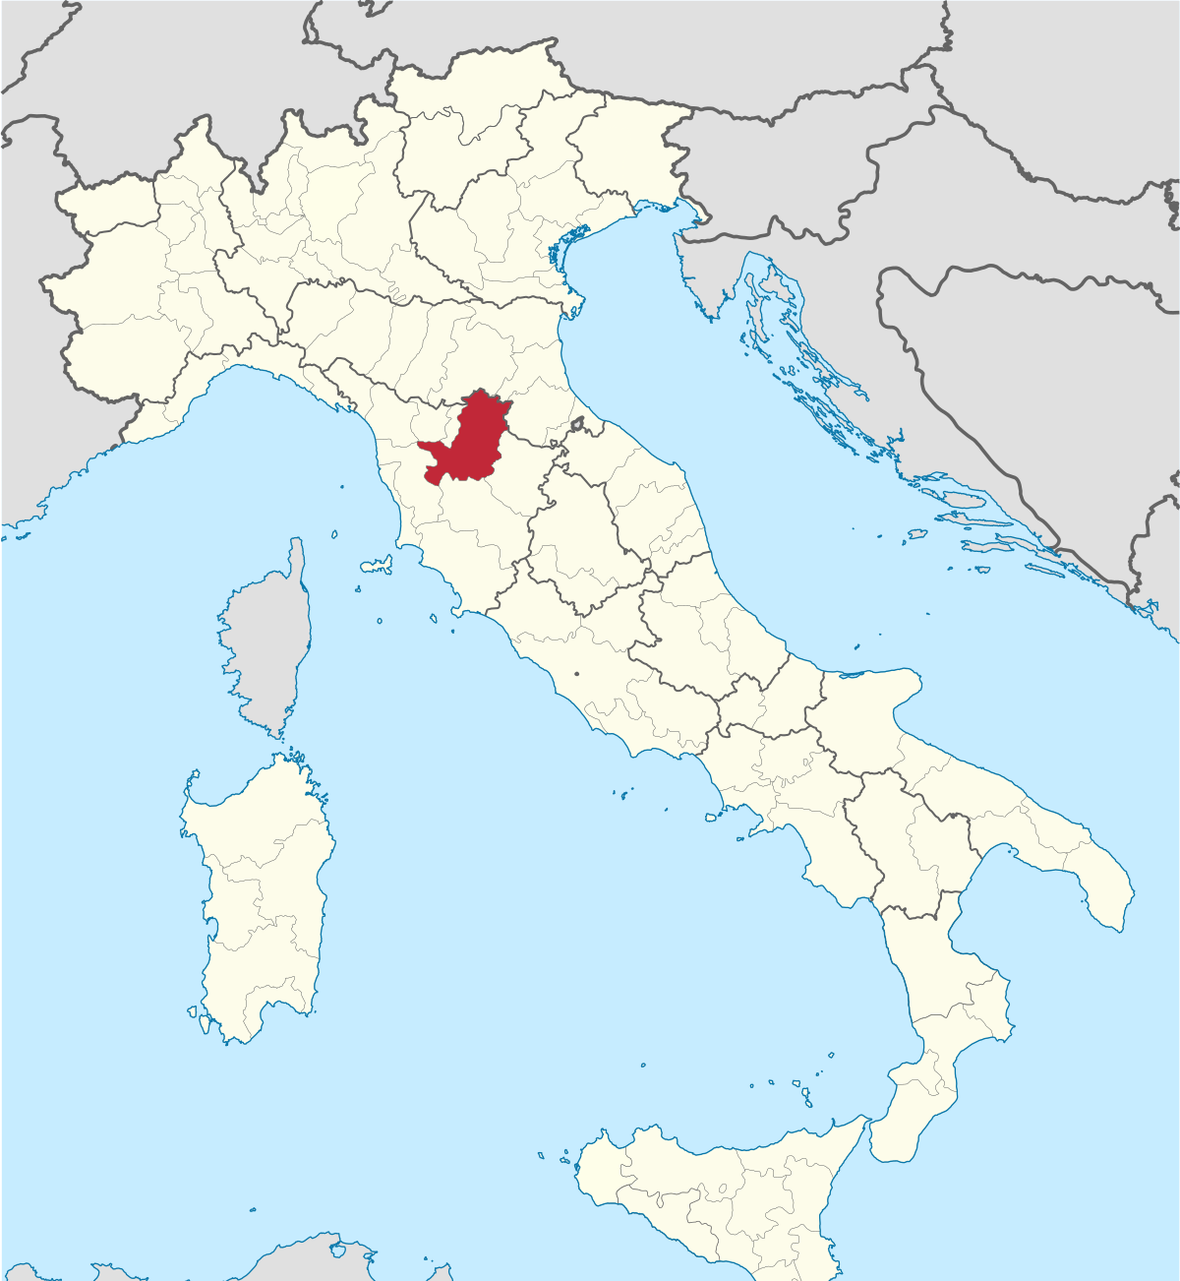
Notes:
First, let’s talk about Florence
Central Italy, capital city of the Tuscany region
383,000 population in 201, 1.5 million in greater Florence region
First established by Julius Caesar in 59 BC
Birthplace of the Italian renaissance

Slide 5
Background

Slide 6
What is APBI?
Accelerated partial breast irradiation
Higher dose, conformal to seroma cavity post operative radiotherapy in lower risk breast cancer patients
Often done in 5 treatments with external beam, instead of 3+ weeks of conventional of hypofractionated whole breast radiation
Intraoperative, brachytherapy techniques also have been studied

Slide 7
Why APBI?
Better sparing of OARs (heart, lung)
Faster treatment for patient
May be more complex to plan and deliver compared to standard photon tangents

Slide 8
Major APBI Trials
NSABP-39
Phase III RCT of WBI 50 Gy vs APBI 3.4-3.85 x 10 fractions BID
Similar, but statistically significant 10 year IBTR rate in favor of WBI (4.8% APBI vs 4.1% WBI)
RAPID, Lancet 2019
Phase III RCT of 3.85 Gy x 10 BID vs 42.5 Gy/50 Gy +-10Gy boost
Non-inferior local control (3% APBI vs 2.8% WBI), significantly worse cosmesis (absolute difference 17.7% at 7 years)
Notes:
NSABP-39
Abstract presented at san Antonio breast cancer symposium 2018 with cosmetic results published in the red journal in 2019
4216 women with APBI using 3DCRT, multicatheter, or single lumbn techniques vs WBI.
Recurrence free interval was less with APBI than with WBI. OS and BCSS did not differ between arms. G3 toxicity slightly more common with APBI (10% vs 7%). Equivalence was shown for patient and photographic assessments, but cosmesis was worse with APBI on physician assessments.
8 year IBTR RAPID
Randomized 2135 women with node negative tumors <=3cm using 3D-CRT (90%) or IMRT (10%). Rates of IBTR similar, but distribution was note. In WBI, more local recurrences were at/near the tumor bed. In those wit hAPBI, more IBTRs occurred elsewhere in the breast. Acute toxicity was less with APBI, but late was worse with WBI, primarily increased in fair cosmesis

Slide 9
APBI-IMRT-Florence Trial Design
Randomized phase III trial
Enrolled n=520 patients with low risk breast cancer post lumpectomy between 2005 and 2013
Randomized between WBI and APBI

Slide 10
Inclusion Criteria
Women >40 years
Maximum 2.5cm tumor, suitable for BCS
Included:
LVI
DCIS
Node positive patients
All molecular subtypes
Exclusion:
Extensive intraductal carcinoma (EIC)
Multiple foci
Surgical margins <5mm
Notes:
All molecular subtypes included

Slide 11
Study Design
Study designed to compare 5-year IBTR rate in APBI and WBI arms
Assumed 5-year IBTR rate of 3% in WBI group, and equivalence of 2 groups if APBI did not exceed 5%
245 patients provided 80% power
ITT and per-protocol analysis performed

Slide 12
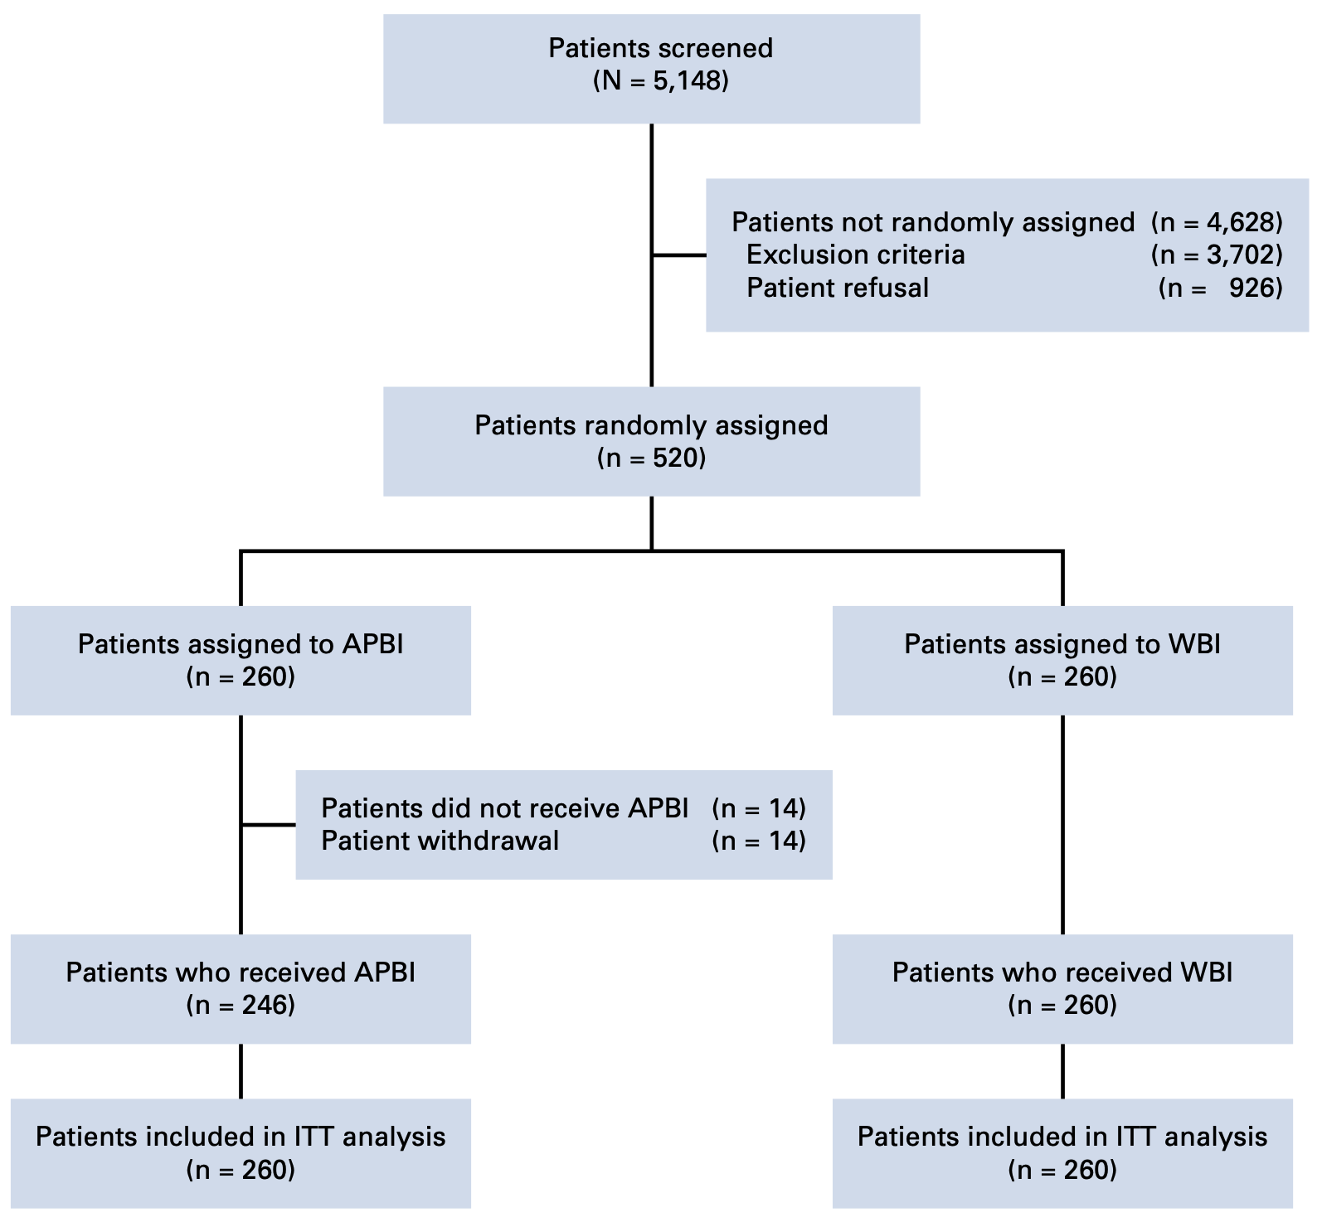

Slide 13
Study Treatments
Patients randomized to WBI or APBI using IMRT in 1:1 ratio
Surgeons asked to place minimum 4 clips at the borders of the surgical bed
CT simulation within 4 weeks after surgery with 0.3cm axial slice thickness

Slide 14
WBRT Arm
Prescription dose 50 Gy / 25 with sequential 10 Gy / 5 surgical bed boost
Wedged photon tangents, and boost delivered with direct electron field
OAR constraints:
Heart: V20<5%
Ipsilateral lung: V20<20%
Heterogeneity
Dmax 55Gy
V52.5<10%

Slide 15
APBI Arm
30 Gy in 5 non-consecutive once-daily fractions
5 6MV non-coplanar fields used
Patients treated supine, with 6 DoF match
No respiratory control used

Slide 16
APBI Targets
CTV was an isotropic 1cm expansion around surgical clips
Cropped 3mm from surface
PTV was 1cm margin to CTV
Cropped 4mm into lung
Cropped 3mm from skin
OARs:
Ipsilateral and contralateral breast
Ipsilateral and contralateral lung
Heart
Spinal Cord

Slide 17
Plan optimization
100% of PTV covered by 95% of prescribed dose (V28.5=100%)
PTV Dmax <105% (31.5 Gy)
PTV Dmin >28 Gy
Uninvolved breast V15 < 50%
Contralateral breast, Dmax <1 Gy
Ipsilateral lung V10<20%
Contralateral lung V5<10%
Heart V3<10%

Slide 18
Quality Assurance
Dose verification for WBI NOT performed pretreatment as only static fields used
1 out of 5 APBI plans verified pretreatment
Pathology QA based on local assessment, consistent with 12th St Gallen International Expert Guidelines

Slide 19
Follow-up
Patients followed up monthly for first 3 months
Every four months for 2 years
Every 6 months at years 2+
Clinical exam at each followup
Mammogram annually

Slide 20
End Points
Primary end point was IBTR rate
Secondary end points:
LRR
DM
Contralateral BC rates
BCSS
OS
Acute/late treatment toxicity
Cosmetic outcomes

Slide 21
End Points
Local recurrence defined as reappearance of BC in the index quadrant
Ipsilateral breast tumors as new BC in other quadrants of same breast
IBTR = LR + new ipsilateral breast tumors
LRR included recurrence in the ipsilateral axillary, supraclavicular, or internal mammary nodal regions
DM were recurrence to visceral and bone sites
Toxicity graded by RTOG and EORTC score
Cosmetic scored on the 4-category Harvard Breast Cosmesis Scale
Notes:
Univariable cox proportional reression model for hazard ratios
Multivariable cox proportional regression model was used to identify independent factors of IBTR
Survival analysis were performed in relation to specific event; no loss to followup was found

Slide 22
Harvard/NSABP/RTOG Breast Cosmesis Grading Scale
Harvard/NSABP/RTOG Breast Cosmesis Grading Score
1 | Excellent | When compared to the untreated breast, there is minimal or no difference in the size or shape of the treated breast. The way the breast feels (its texture) is the same or slightly different. There may be thickening, scar tissue, or fluid accumulation within the breast, but not enough to change the appearance
2 | Good | There is a slight difference in the size or shape of the treated breast as compared to the opposite breast or the original appearance of the treated breast. There may be some reddening or darkening of the breast. The thickening or scar tissue of the breast causes only a mild change in the shape or size.
3 | Fair | Obvious difference in the size or shape of the treated breast. There can be moderate thickening or scar tissue of the skin and the breast, and there may be obvious colour changes.
4 | Poor | Marked change in the appearance of the treated breast involving more than one quarter of the breast tissue. The skin changes may be obvious and detract from the appearance of the breast. Severe scarring and thickening of the breast, which clearly alters the appearance of the breast, may be found

Slide 23
Results

Slide 24
Patient characteristics
Median follow up 10.7 years (SD 2.6 years)
Most patients:
>50 years old
Grade 1-2 tumors
<2cm
Node negative
ER+ve

Slide 25
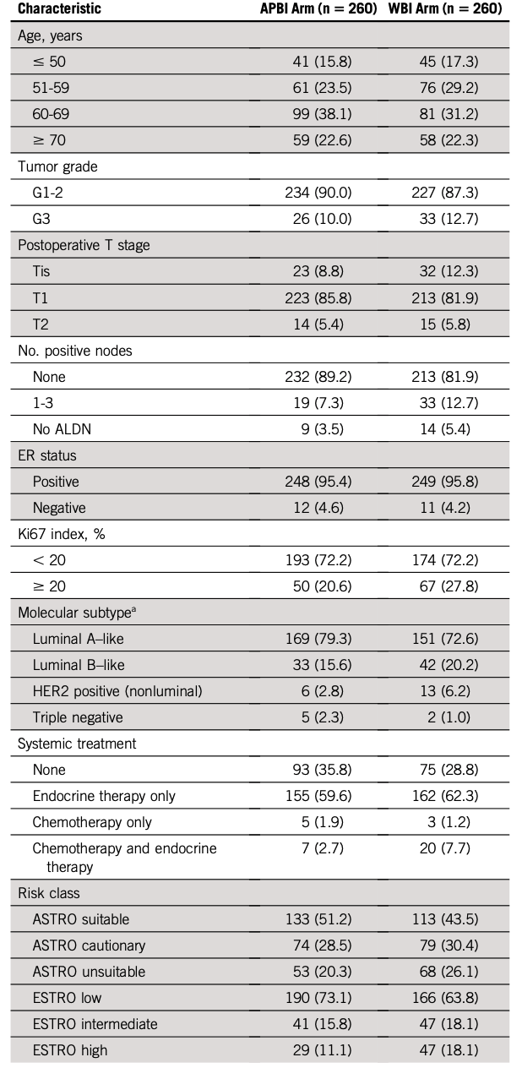
Notes:
Well balanced overall
More node positive patients in WBI arm
Higher grade tumors in WBI arm
Third of patients had no systemic therapy
Half to two thirds were ASTRO suitable/ESTRO low

Slide 26
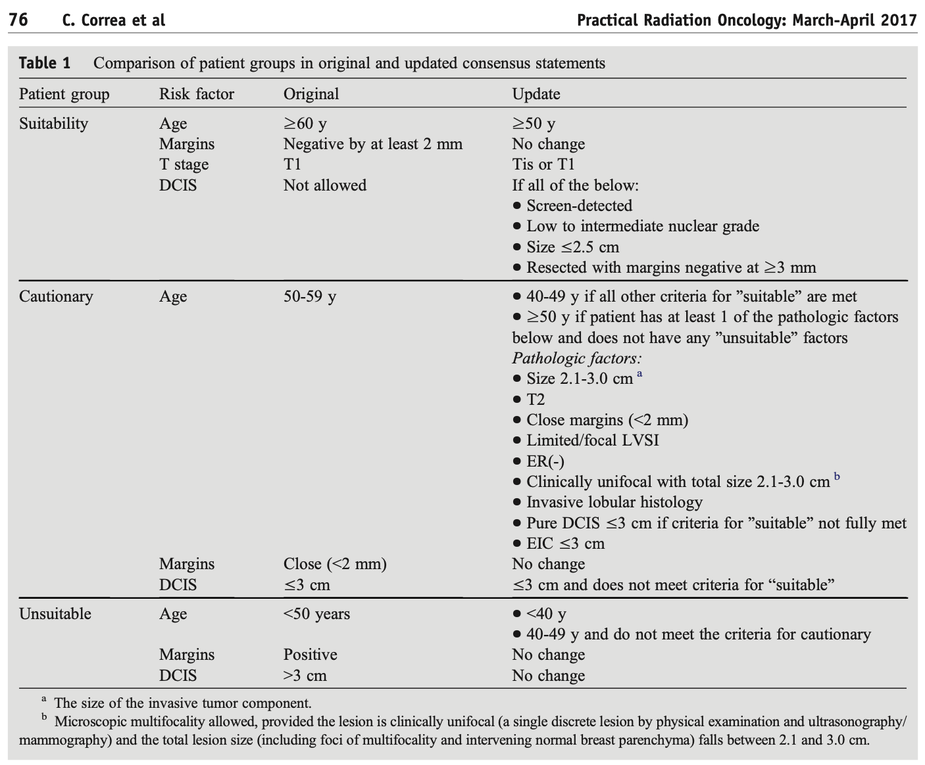
Notes:
Updated ASTRO suitability guidelines

Slide 27
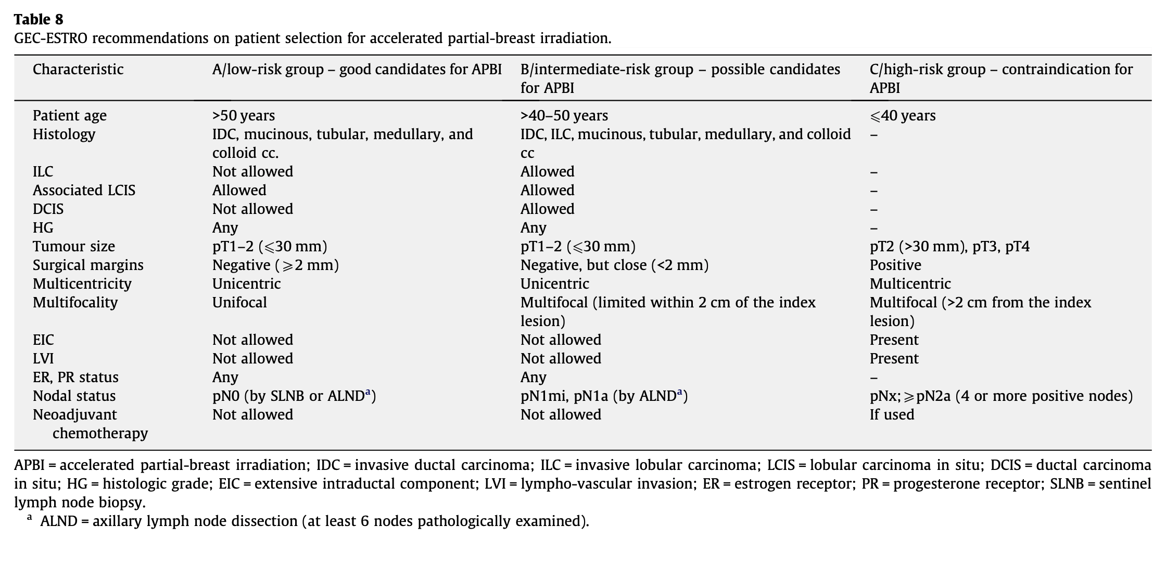
Notes:
GEC-ESTRO suitability guidelines

Slide 28
10 year cumulative IBTR 2.5% WBI, 3.7% in APBI, P = 0.40
Mean time to IBTR was 4.0 years
Notes:
Analyzed ITT, also reanalzyed per protocol for variance
Absolute difference is 1.2%
Within the noninferiority margin

Slide 29
10 year cumulative incidence of LRR was 2.9% in WBI and 3.7% in APBI, P=0.58
Notes:
Absolute difference was 0.8%

Slide 30
10 year cumulative DM was 3.2% in WBI and 2.9% in APBI, P=0.83
Median time to DM was 4.1 years
Notes:
Absolute difference is 0.3%

Slide 31
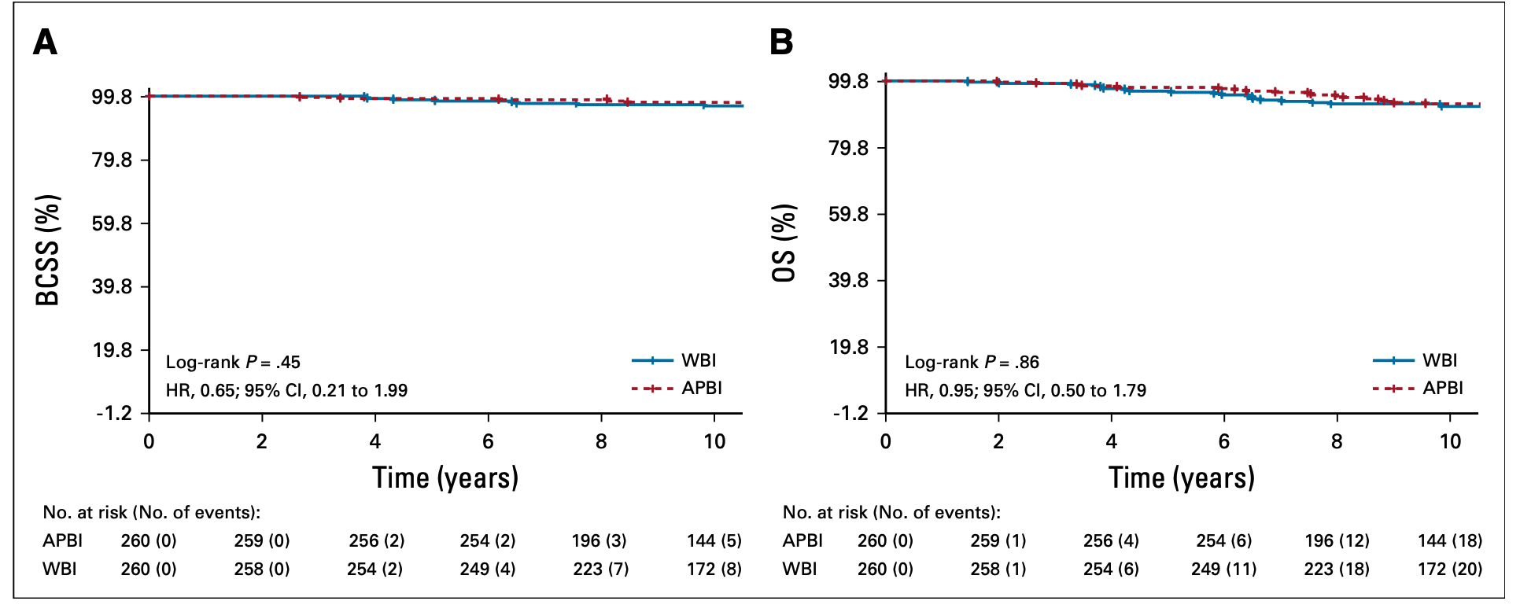
Notes:
No significant differences at 10 years

Slide 32
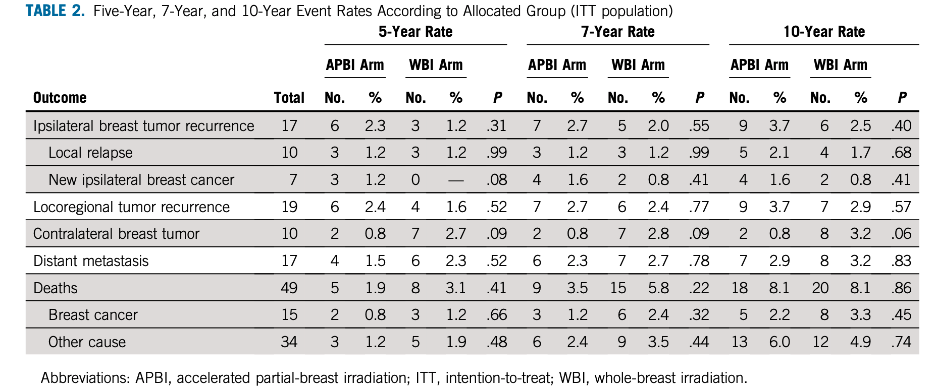
Notes:
Fairly balanced
If you include IBTR and Contralateral breast tumor as a synthetic endpoint, you get 11/260 and 14/260, P=0.58 (Sorry dr wu for post hoc calculating haha)
3.2% vs 0.8% at 10 years.

Slide 33
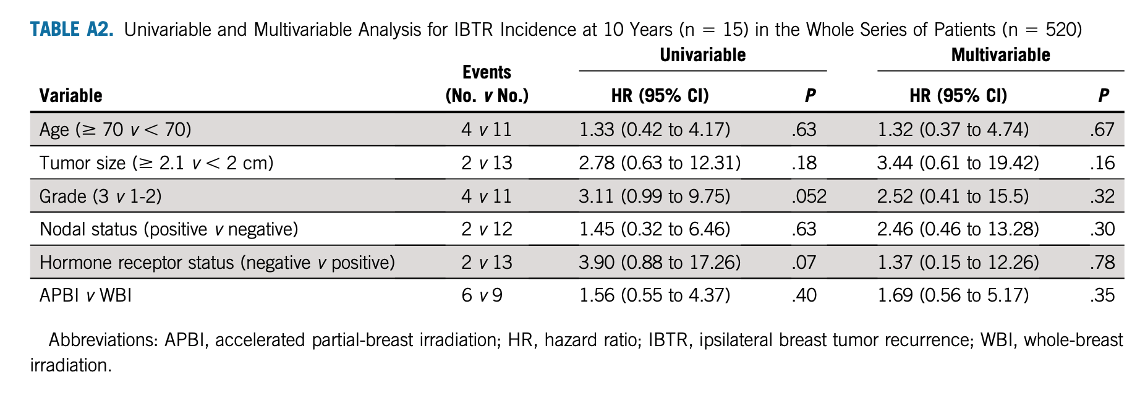
Notes:
Nothing significant on the univariable or multivariable, although grade is close on univariable.

Slide 34
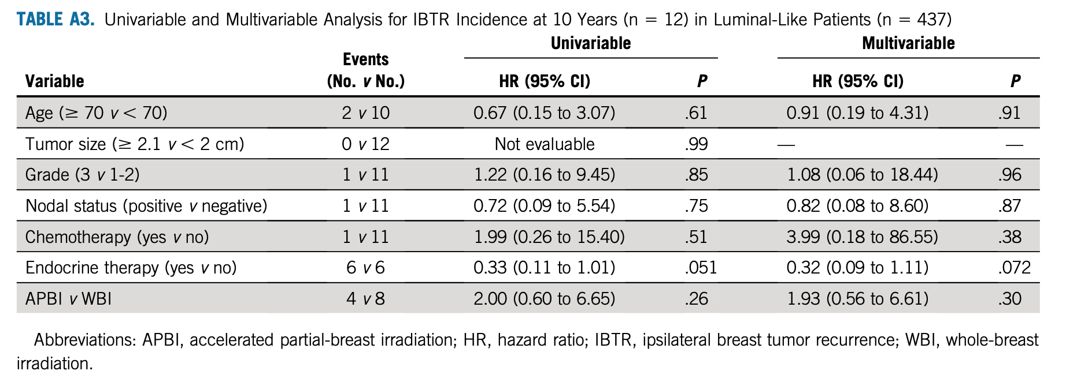
Notes:
Endocrine therapy almost significant. Which makes sense, this is the luminal-like cohort.

Slide 35
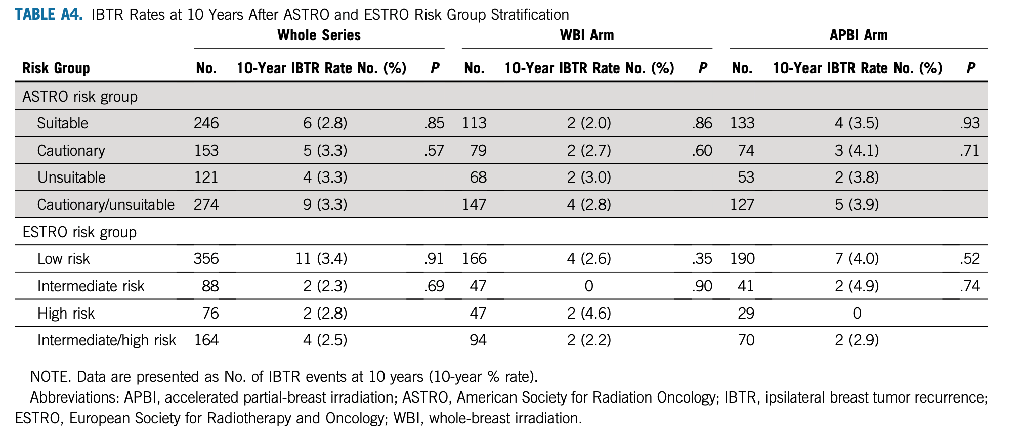

Slide 36
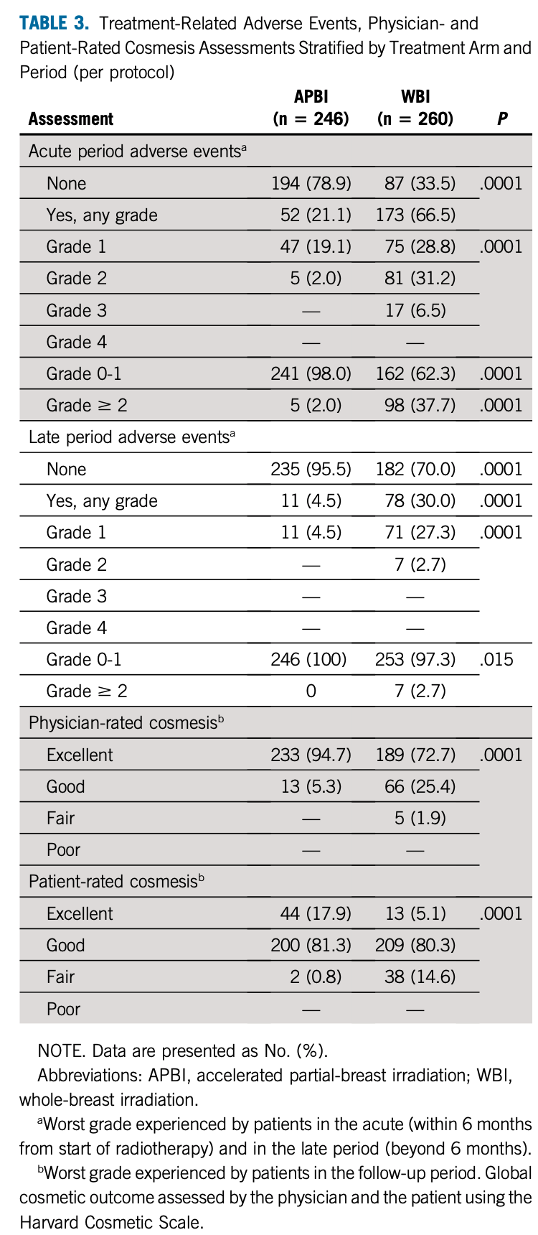
Safety and Cosmesis
Notes:
80% of women had no side acute effects with APBI
95% of women with APBI had no late adverse events
We are not given any time point for cosmesis, but rather ‘worst’ cosmesis experienced by patient

Slide 37
Discussion

Slide 38
Inclusion
Patient inclusion criteria was practical, and generally reflected ASTRO and ESTRO guidelines
Similar to ACCEL inclusion locally
(ACCEL restricted one of G3 or LVI, not both)

Slide 39
Intervention – does it make sense?
5 field non-coplanar IMRT similarly planned as ACCEL
Probably not meaningfully different than VMAT, though not tested, and provides more thoughtful tissue sparing from low dose wash

Slide 40
Select prescription comparisons
Dose/fraction | EQD2(a/b=3) (Gy) | EQD2(a/b=10) (Gy)
50 Gy / 25 | 50 | 50
42.56 Gy / 16 | 48.2 Gy | 44.9 Gy
30 Gy / 5 | 54 | 40
27 Gy / 5 | 45.4 | 34.7
26 Gy / 5 | 42.6 | 32.9
Notes:
Does not include any time effect for every other day fractionation

Slide 41
Why non-daily fractionation? Does it make a difference?
Concerns raised for late toxicity with RAPID that 6h BID fractionation may not be entirely enough for normal tissue repair
Tumor repopulation?
Breast cancer slow growing, and treatment time is prolonged by only 5 days, this is double than if performed over 1 week ( 10 days vs 5)
Extrapolating from SBRT literature
Better local control with lung SBRT with nonconsecutive fractionation, thought due to improved reoxygenation, Alite et al, Radiother Oncol 2016
Other data is nonconclusive
Less fatigue with nonconsecutive fractionation with liver SBRT, Hasan et al, PRO, 2018
Notes:
Though other data is mixed
Every other day fractionation does impact patient’s overall treatment time
Maybe more normal tissue repair with large doses perfraction

Slide 42
Does the control arm make sense?
50 Gy in 2 Gy / fraction is not standard of care in Canada, and transitioning out of standard of care in USA
Older techniques used:
Wedged tangents
Direct electron field
Not more modern field-in-field or IMRT
Most patients would probably not have required boost per authors, and so toxicity also overrepresented in this arm compared to AB patients
Notes:
Pignol et al 10 year f/u of IMRT 2016 IJROBP
Still, toxicity of APBI also low

Slide 43
Can we learn from tumor biology?
Nothing significant on univariate or multivariate analysis
Grade and hormone status came close, but may be underpowered for any signal
No significant differences noted in suitability criteria

Slide 44
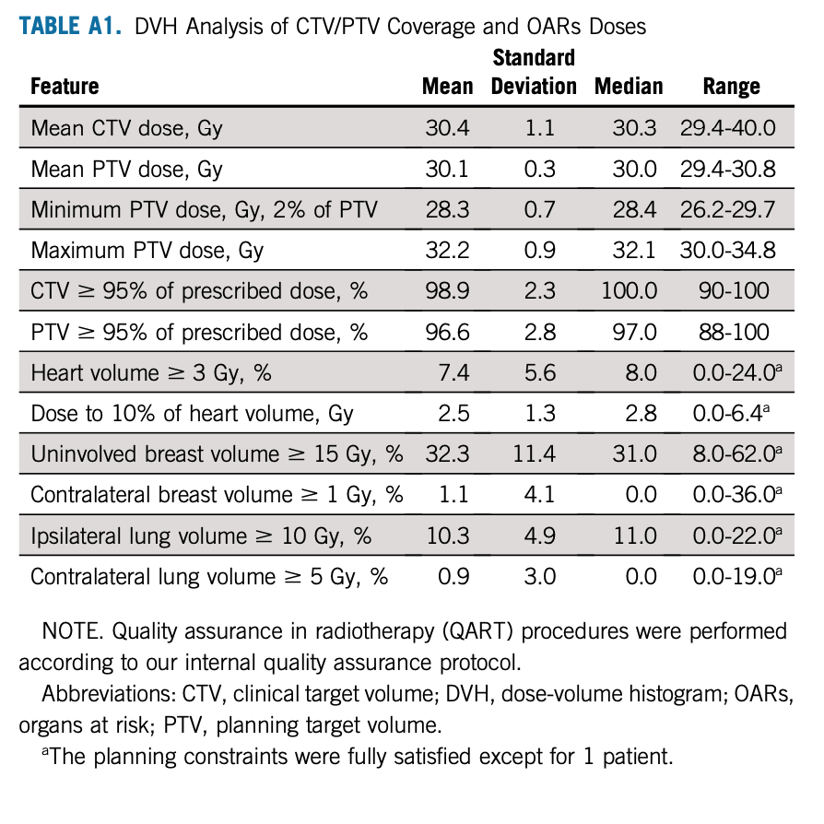
Contralateral breast dose – is IMRT better?
Notes:
Median 0 Gy to uninvolved breast. Mean of 1 Gy.
It’s been previously shown that standard wedges as used in this trial do increase contralateral breast dose as compared to electronic dynamic wedges.

Slide 45
Contralateral dose comparisons
Observed doses with MOSFET dosimeter
Prabhakar et al., Technology in Cancer Research and Treatment 2007
Notes:
Whole breast. APBI fields even better

Slide 46
Trial conclusions
10 year IBTR rate with external beam IMRT-APBI is low, not significantly different from conventionally fractionated WBI
Comparable outcomes observed
Favourable acute and late toxicity and cosmesis in APBI arm
IMRT-APBI 30 Gy / 5 is ‘attractive’ option with low-risk early BC

Slide 47
APBI
How does this compare?

Slide 48
Compared to RAPID
Dosing strategy opposite of RAPID – instead of BID, dosing non-consecutive days
IMRT much more conformal than RAPID plans (90% 3D)
Much more favourable toxicity

Slide 49
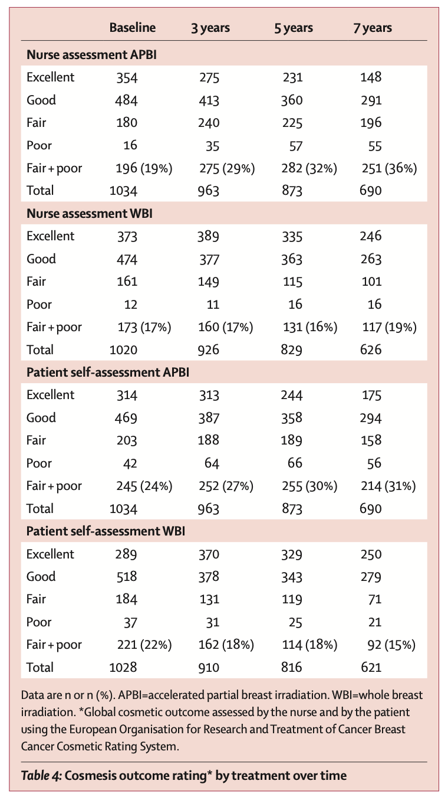
RAPID Cosmetic Results

Slide 50
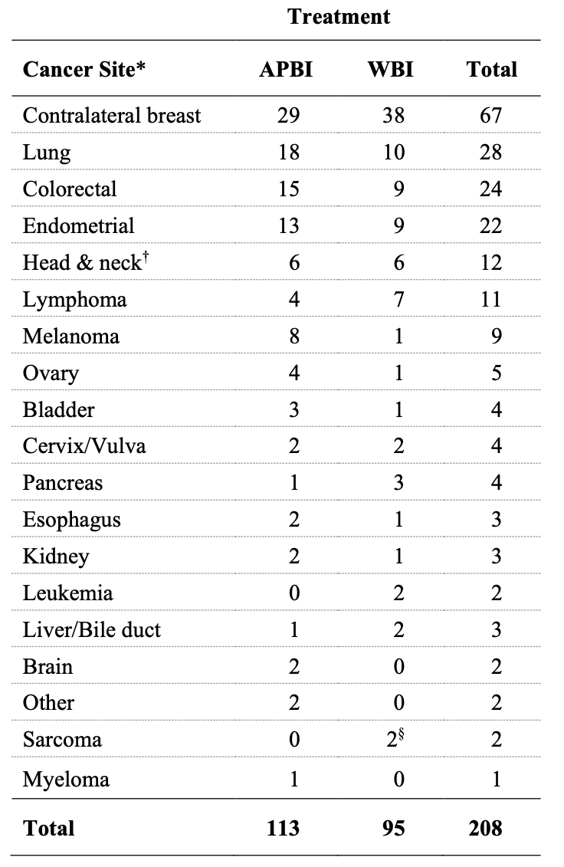
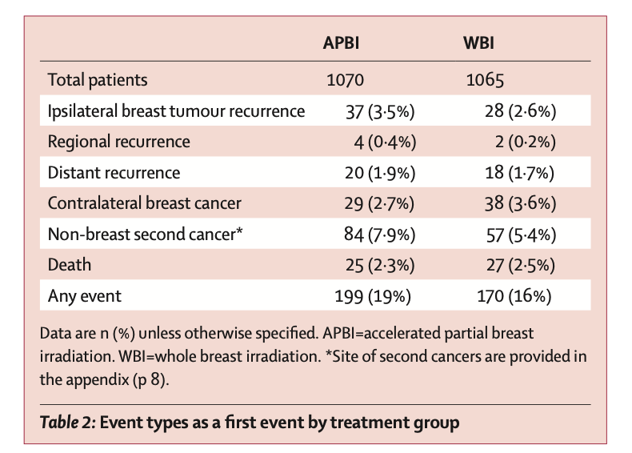
Notes:
Lung, melanoma, higher. Probably others are spurious

Slide 51
Opposing findings with contralateral breast cancer – IMPORT-LOW
IMPORT-LOW is a phase III RCT which randomized patients to
40 Gy / 15 whole breast
36 Gy whole breast with sequential boost to 40 Gy partial breast
40 Gy / 15 partial breast only, ‘mini-tangents’
Offers a comparator to APBI trials as volumes were changed independent of dose, as opposed to both volumes and dose

Slide 52
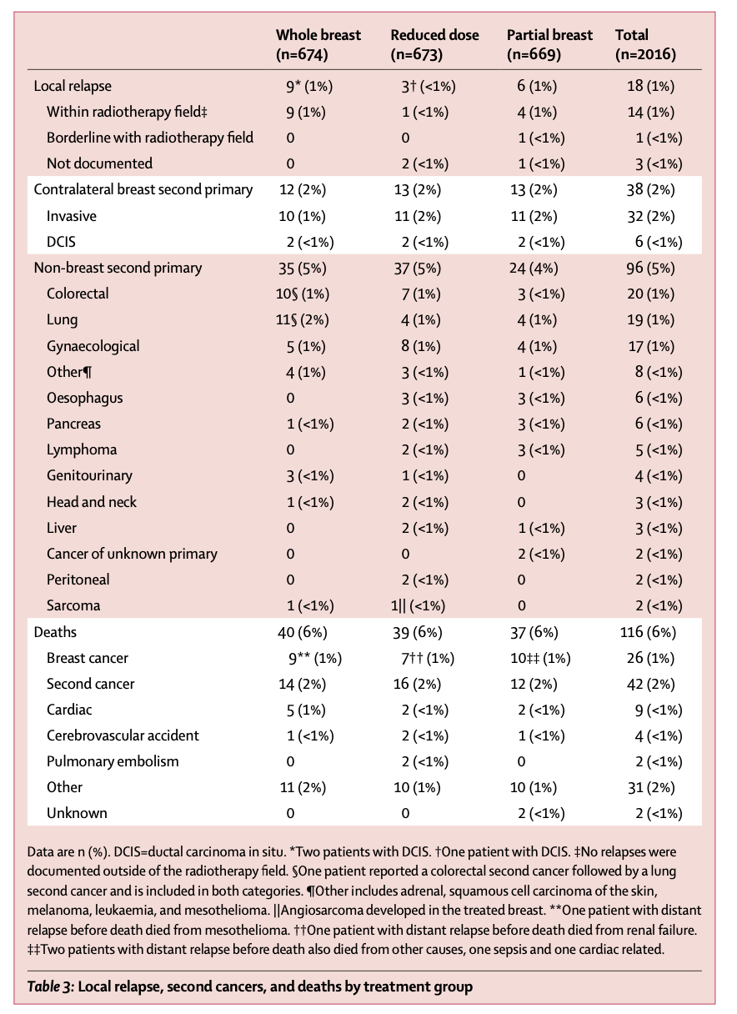
Notes:
2% with all groups
Maybe the reduced dose with the APBI plays a role. Maybe it’s spurious. Non breast second primaries were less here than in other trials.

Slide 53
Compared to ACCEL
ACCEL inclusion criteria
<=3 cm primary tumor
Margins >=2mm
‘Excellent’ or ‘Good’ cosmesis prior to RT
DCIS or invasive breast cancer
Excluded HER2+, Triple negative, breast implants, lobular histology, could not have both G3 and LVI
Prescription dose different
27 Gy/5 daily vs 30 Gy / 5 non-consecutive daily
PTV margin 0.7c m in ACCEL vs 1.0 cm in APBI-IMRT Florence
Notes:
Single arm multicentre prospective phase 2
Calculated dose base on a/b=2 equivalence

Slide 54
Select prescription comparisons
Dose/fraction | EQD2(a/b=2) (Gy) | EQD2(a/b=3) (Gy) | EQD2(a/b=10) (Gy)
50 Gy / 25 | 50 | 50 | 50
42.56 Gy / 16 | 49.6 Gy | 48.2 Gy | 44.9 Gy
30 Gy / 5 | 60 | 54 | 40
27 Gy / 5 | 50 | 45.4 | 34.7
26 Gy / 5 | 46.8 | 42.6 | 32.9
Notes:
Does not include any time effect for every other day fractionation

Slide 55
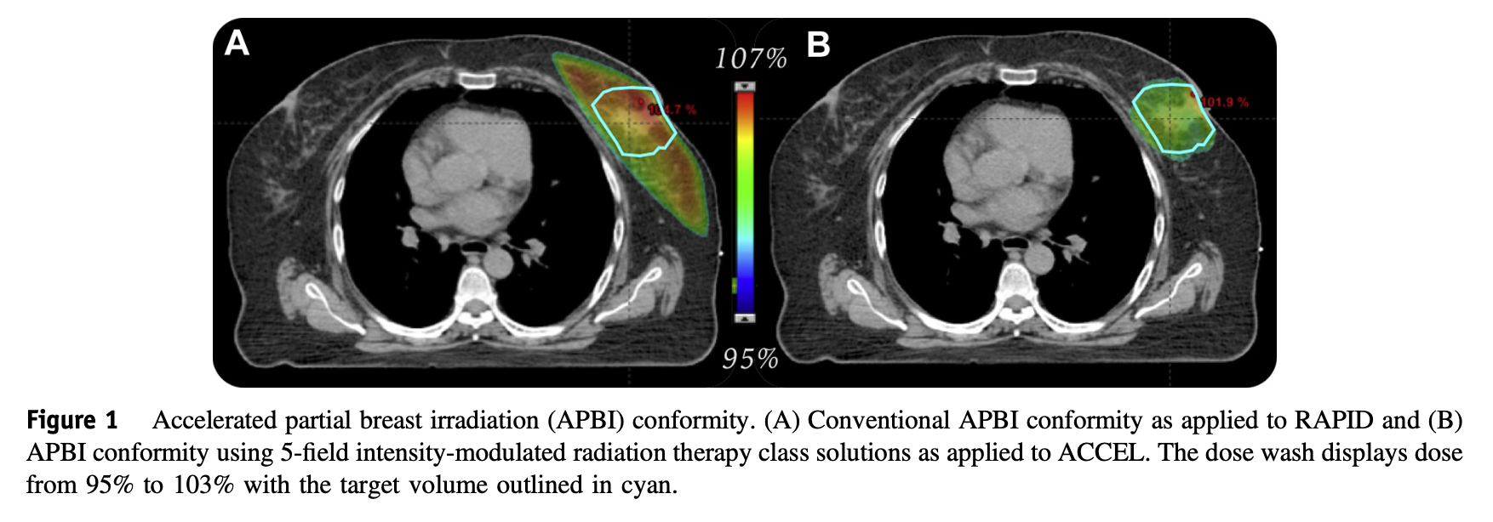

Slide 56
Notes:
Median tumor size 1.2cm – same, median T1, size not reported in IMRT-Florence

Slide 57
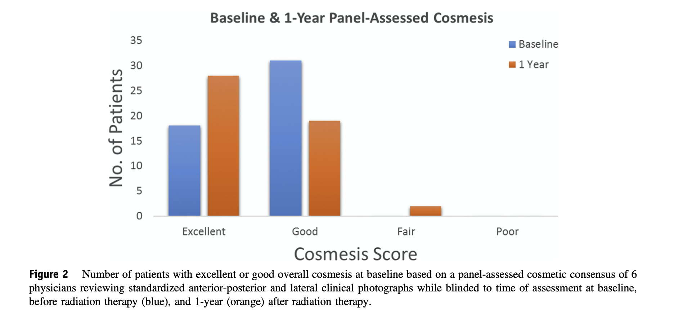

Slide 58
 | Year 0 | Year 1
Grade 0 fibrosis | 55% | 60%
Grade 1 fibrosis | 45% | 40%
Notes:
Small Improved fibrosis over time

Slide 59
 | Baseline | Year 1
Excellent | N=18 (33%) | N=28 (51%)
Good | N=31 (56%) | N=23(42%)
Fair | N=6 (11%) | N=4(7%)
Poor | N=0 (0%) | N=0(0%)
Notes:
Panel assessed cosmesis (separate from MD assessed); panel of 6 physicians
Not panel – physician and patient rated cosmesis
We see the panel some minor discrepancies, MD tending to rate better
Going by this, looks like Florence better
Even though the cosmetic score seems like a reasonable tool, especially in Florence this is non blinded and subject to bias from both the physician and the patient. No central QA in Florence as in ACCEL, but Florence does include patient ratings.

Slide 60
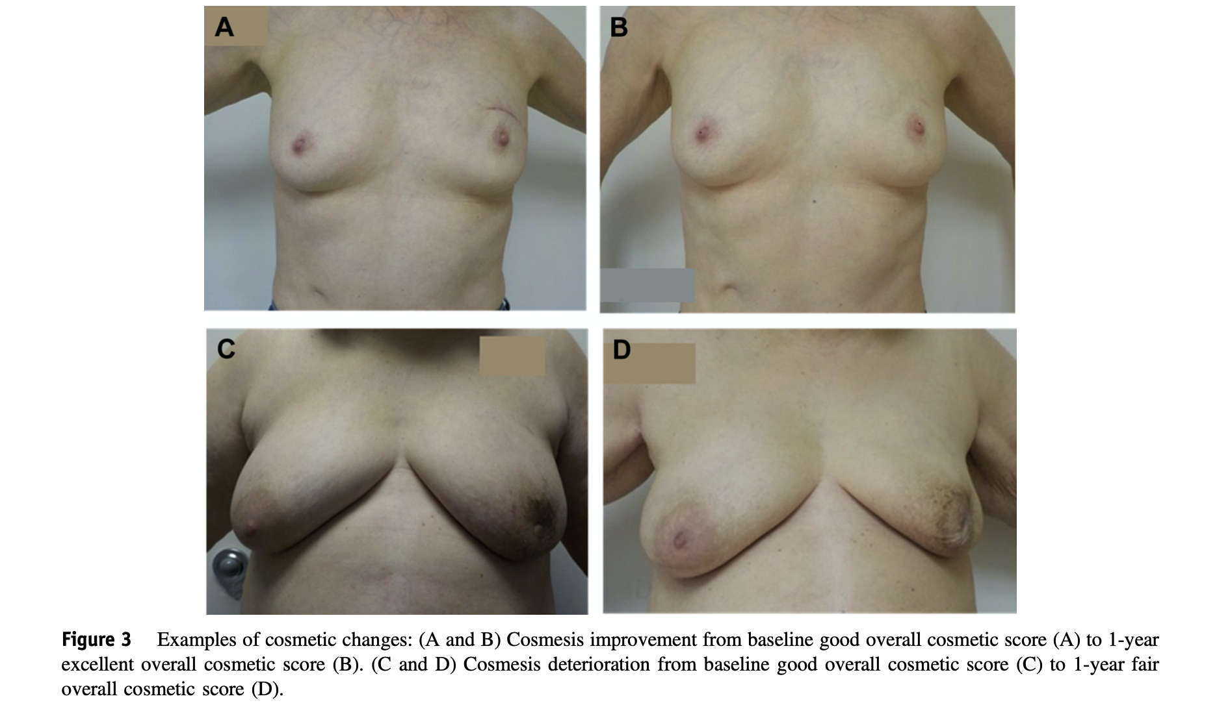

Slide 61
Largest differences
Choice of fractionation (daily vs non-consecutive days)
Given difference in methodologies, no convincing evidence of cosmesis difference
LC not yet reported for ACCEL, no direct comparison arm
My personal pre-test probability is that likely are comparable, though impossible to formally evaluate

Slide 62
UK Fast-Forward Summary
Randomized phase III comparing 40 Gy / 15 vs 27 Gy / 5 daily vs 26 Gy / 5 daily
Published April 28,2020
New ‘standard’ many places
COVID-19 friendly schedule
Included pT1-3, pN0-1, M0 patients
Boost allowed (about 25% received)
Median followup about 6 years

Slide 63
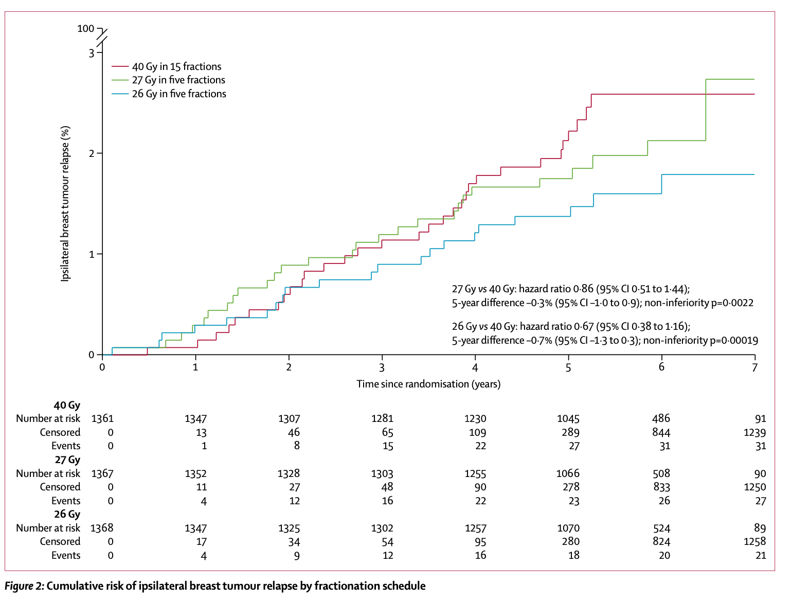
Notes:
Blue line is 26 Gy
27 Gy line is Green.
40 Gy line is red
Non inferiority trial
Still, lowest event rate in ‘lowest’ dose arm, though thought spurious by trialists
Contralateral breast cancer about 1.3-1.5% depending on arm
Non-breast primary second cancers about 2.7-3.2% of patients, not SS

Slide 64
Breast shrinkage ~6%
Breast distortion ~5%
Breast induration ~1.6%

Slide 65
Does APBI make sense in FF era?
UK FF now standard of care in UK for most node negative patients
UK FF easier to plan - ‘tangents’
APBI more ‘technical’ to deliver
Non-coplanar beams/couch kicks
Daily CBCT (at least on ACCEL)
Is cosmesis better with APBI?
Is integral dose significant in APBI?
Is contralateral breast dose significant in WBI?
5 fraction in one week is more palatable to system and patients as compared to non-consecutive fractionation
Notes:
Not even including more unique options such as HDR, LDR brachytherapy

Slide 66
Represents important de-escalation of treatment for low risk patients
Given that 5 fraction WBI an option, 5 fraction APBI might make sense in those who have:
Lack of access to DIBH techniques (not us!)
Large breast size
Wish to spare lung and heart dose
Notes:
Opinion and summary paper by tim Whelan published this October with Florence data
I don’t mean to be prescriptive. Just raise questions as evidence and data continues to evolve

Slide 67
Discussion

Slide 68
Special Thanks
Dr Grendarova and ACCEL trial team

Slide 69
Fini

