Slide 1
Sarcoma Group Research Update
April 27, 2021

Slide 2
Objectives
Review MRI Simulation in Sarcoma
Review chemoradiotherapy and ‘modified Eiber protocol’ in extremity soft tissue sarcoma

Slide 3
Sarcoma Review
And Rationale for MRI Simulation

Slide 4
History of Sarcoma
Alexis Boyer (1757-1833) first to distinguish exostosis, gumma of bone, spina ventosa, and osteosarcoma
1891 - First patient with sarcoma cured by immunotherapy, reported 1914 by William B Coley (1862-1936)
1905 - Dr Ernest A Codman (1869-1940) publishes The Use of the X-ray in the Diagnosis of Bone Diseases
Peltier, J Surg Onc 1985; 30:201-205
Notes:
Of course, to understand a disease, one must first start at the beginnings
The term osteosarcoma first described in this book
The head and neck sarcoma was probably a melanoma, as back then was classified as a melanosarcoma

Slide 5
History of Sarcoma
1921 - James Ewing describes diffuse endothelioma of bone (then called Ewing’s tumor by Codman)
1931 - Sir Stanford Cade advocated 6000 rad over six weeks to primary
If no mets over 6-9 months, then amputate
1941 Ferguson AB: Treatment of osteogenic sarcoma. J Bone Joint Surg 22:92-100, 1940
“Results indicate that early amputation not only is not the best treatment, but that it actually tends to assure the death of the patient”
Treatment recommended:
Avoid early amputation
Delay amputation
Give X-ray radiation prior to amputation
Radiate, excise, and implant bone grafts before amputation
Repeat excision before amputation
Peltier, J Surg Onc 1985; 30:201-205
Jaffe et al., Sarcoma. 2013; 2013: 203531.
Notes:
Even then surgeons were biased that introducing a delay allows for selection between slower and rapidly growing turmors that metastasized early.
Surgery was set back for years based on this recommendations
Survival of 8% of those amputated within 6 months vs 28% of those amputated after 6 months

Slide 6
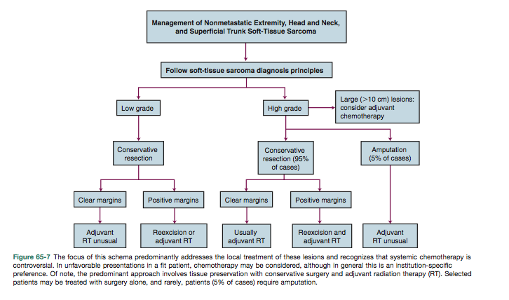
Modern Day Treatment
Alektiar, Soft-Tissue Sarcoma, Clinical Radiation Oncology, 2016, p1355

Slide 7
Sarcoma Epidemiology
~1.5% of adult malignancies
~7.5% of pediatric malignancies
Varied histologies
Primary can arise anywhere
(really anywhere)
Ferrari et al, Pediatr Blood Cancer 2011;57:943–949
Notes:
Based on SEER data

Slide 8
Distribution of Sarcoma Primary Sites
Ferrari et al, Pediatr Blood Cancer 2011;57:943–949
Notes:
Extremeties

Slide 9
Sarcoma Volume Delineation
GTV
CTV
PTV

Slide 10
‘Classical’ Sarcoma Planning
Murphey MD, Robbin MR, Mcrae GA et-al. The many faces of osteosarcoma. Radiographics. 17 (5): 1205-31.

Slide 11
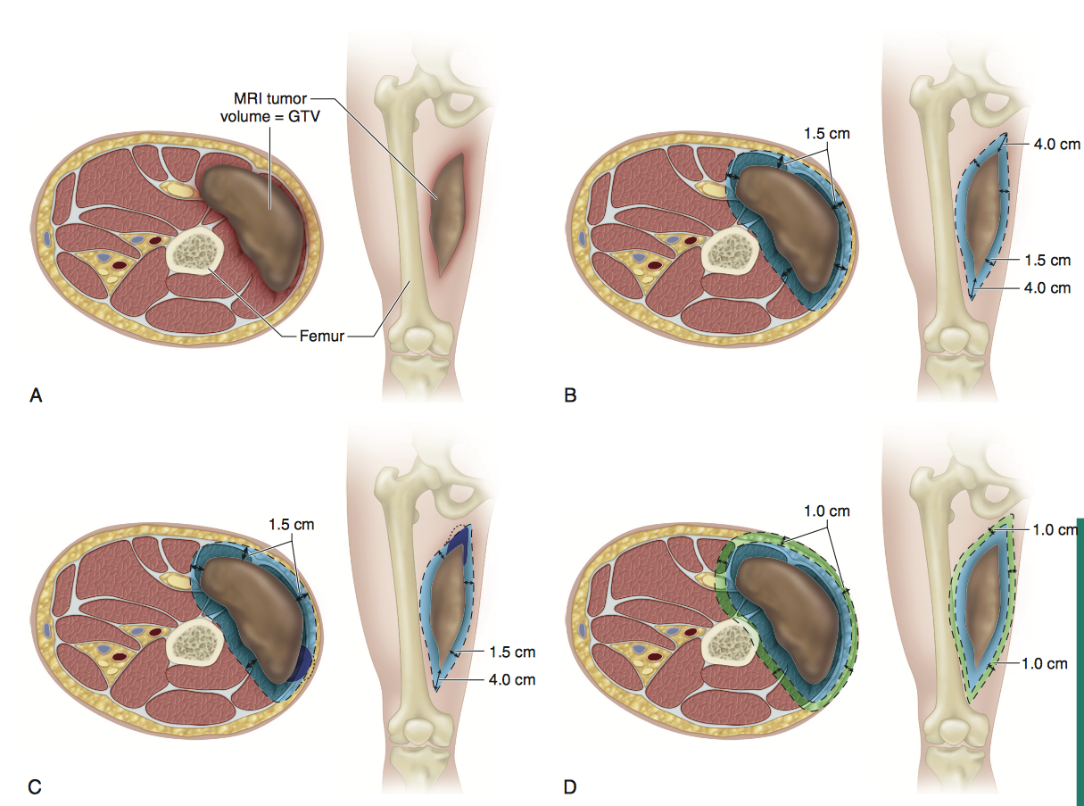
Conventional Margins
Alektiar, Soft-Tissue Sarcoma, Clinical Radiation Oncology, 2016, p1359-1360
Notes:
Conceptually, for preoperative radiation, this is how it used to be done. About 5cm to block from GTV
Talk about pseudocapsule of tumor
Note CTV is trimmed from uninvolved fascial compartments

Slide 12
Radiation Clinical Trials in Sarcoma

Slide 13
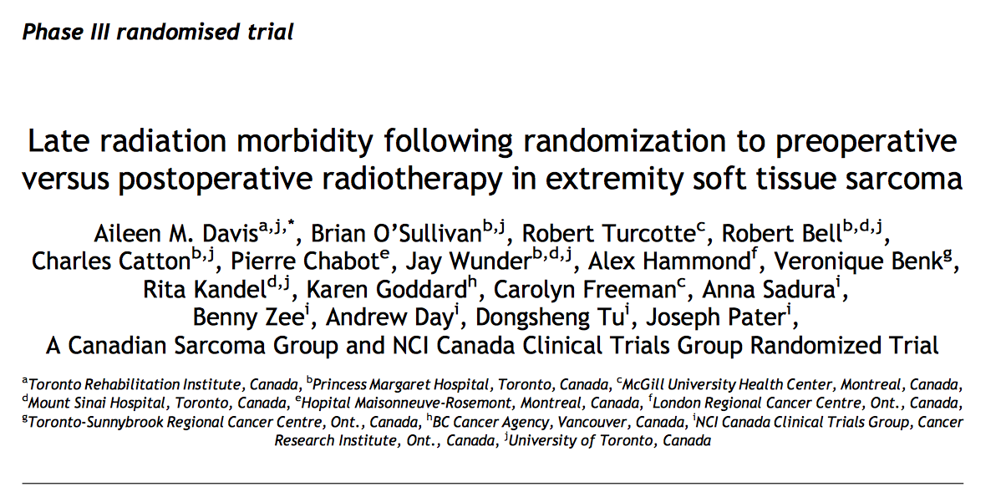
Preoperative Versus Postoperative RT
NCIC SR2
Notes:
SR2 - Randomized 190 patients stratified by tumor size (<10cm > 10cm) to 50 Gy preop vs 66-7- Gy postop)
1994-1997

Slide 14
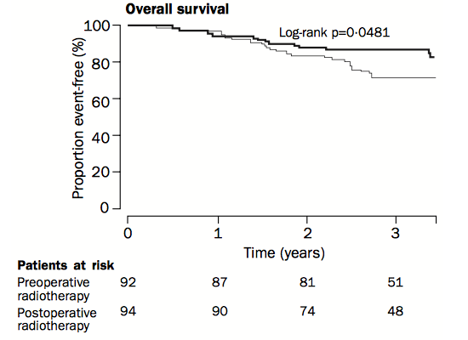
NCIC SR2 Results
Equivalent LC and OS between preoperative and postoperative groups
Higher incidence acute wound complications in preoperative
Postoperative group had trend towards increased late toxicity at 2 years (p=0.07) of
Subcutaneous fibrosis
Joint stiffness
Edema
Notes:
Long term toxicity correlated with decreased disability

Slide 15
NCIC SR2 Results
Larger Field size risk factor for:
Subcutaneous fibrosis
Joint stiffness
Edema
Confounding variables:
Larger field sizes post operatively
D_{max} higher postoperatively
Notes:
Long term toxicity correlated with decreased disability

Slide 16
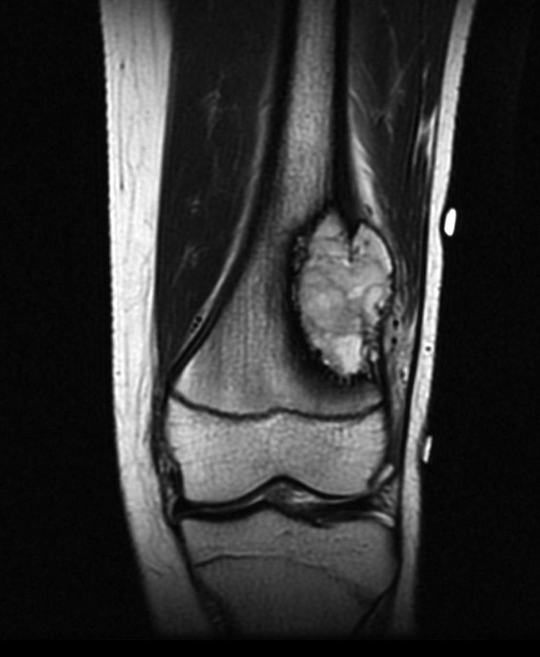
Technology Advances in Sarcoma Care:
Better diagnostic imaging/proper staging
Transition from 2D to 3D-CRT and then IMRT radiotherapy
Improvements in onboard imaging and IGRT
Desire to reduce treatment toxicity
Notes:
Will Rogers was an early century comedian, not actually a significant contributor to STS treatment. But modern DI does absolutely play a role.

Slide 17
Notes:
Phase II RTOG trial with preoperative radiotherapy with daily IGRT to assess impact of margin reduction

Slide 18
RTOG 0630 Treatment
Daily IGRT
PTV margin now +0.5 cm instead of +1.0 cm
CTV Margins
Instead of +4 cm longitudinally, 1.5cm radially
G2/G3 histology, $≥$8 cm tumor length
+3.0cm longitudinal expansion, +1.5cm radially
G1 histology, <8cm tumor length
+2.0cm longitudinal expansion, +1.0cm radially

Slide 19
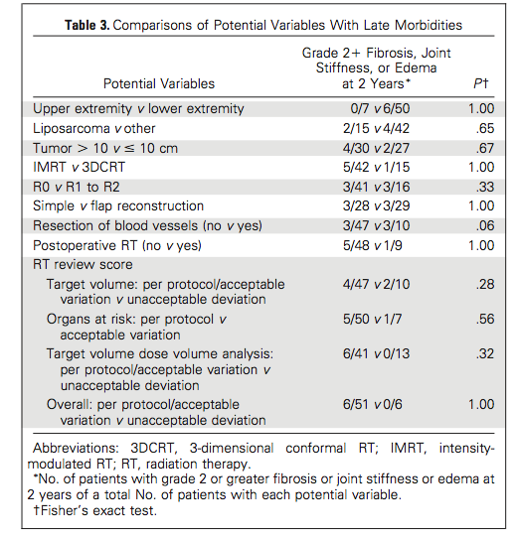
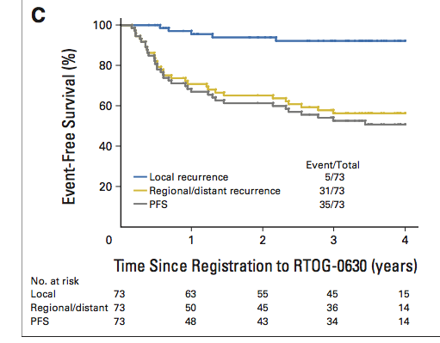
RTOG 0630 Results
Notes:
In the paper, at least one of the in field recurrences the GTV was not adequately covered when compared to the MRI
These failure differences are using the same definitions of SR2

Slide 20
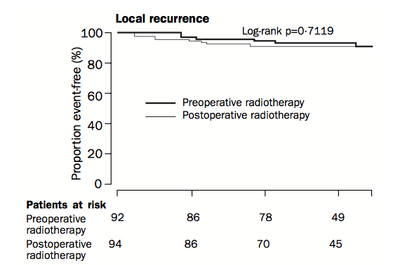
RTOG 0630 and NCIC SR2 Comparisons
57 of 79 patients were compared at the same 2 year late toxicity endpoint as in SR2
6/57 (10.5%) had ≥G2 late toxicities in 0630 compared to 27/73 (37%) in SR2 (P<0.001)
SR2 LC5 = 93% vs 0630 LC4 = 93%
Notes:
Will all the caveats that come with direct trial comparisons…
No marginal field recurrences

Slide 21
RTOG 0630 Conclusions:
Smaller field sizes enabled by IGRT contribute to
Less late toxicity
Similar local control

Slide 22
Workflow for PTV Creation
GTV
CTV
PTV
Can we make this more accurate?
Reduction based on RTOG 0630
Reduction based on setup, IGRT

Slide 23
GTV Delineation
CT sim alone not enough for disease delineation given soft tissue nature
MRI shows limits of sarcoma involvement much more accurately
Errors in GTV delineation are introduced from registration of diagnostic scans to simulation scans
Vickers et al., BJR 2019; 1: 20180022.
Kransdorf et al., AJR 2000;175: 575-587
Notes:
There is evidence showing MRI fusion planned preoperative sarcoma radiotherapy plans results in GTV shrinkage by ~21cc on average. Small, but helps.

Slide 24
Sarcoma Imaging
Notes:
Top left – CT Sim
Top right – T2 Fat Sat MRI Sim
Bottom left – T1 + Gad MRI Sim
Bottom right – T1 + Gad Diagnostic MRI – fortunately, in this circumstance there is a good match with the surface contour.
Sometime PET is used depending on the situation
Great quality on the Gad+contrast scan!!

Slide 25
Diagnostic to Simulation Registration Errors
Time delay from diagnostic imaging to simulation imaging
Can be upwards of month or more time interval, where tumor has opportunity to grow and invade and may result in undercontouring of tumor
Diagnostic positioning varies greatly from treatment positioning
Extremities by nature, have large degrees of freedom of movement due to joints
Even if external contours are similar, muscle (and therefore sarcoma) positioning vary and therefore are not reliable
Notes:
Most importantly is variations in anatomical positioning

Slide 26
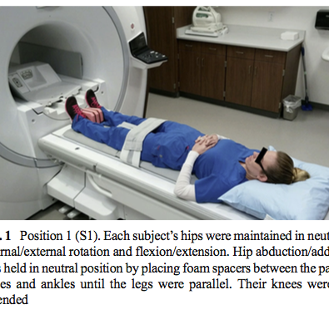
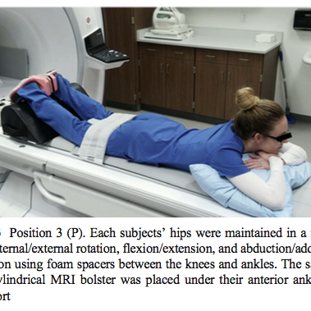
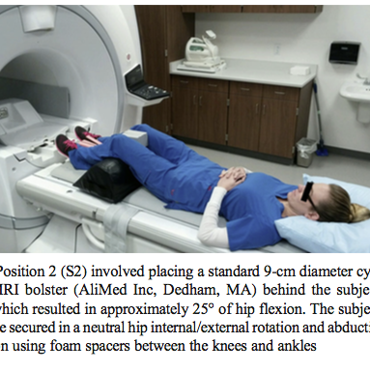
Allen Li et al., Pract Radiat Oncol. 2016 Jul-Aug; 6(4): e135–e140
Notes:
That difference is greater than the sum total distance gained with IGRT ( based on secondary analysis of RTOG 0630 – need 1.5cm CTV to PTV expansion to account for day to day variation)

Slide 27
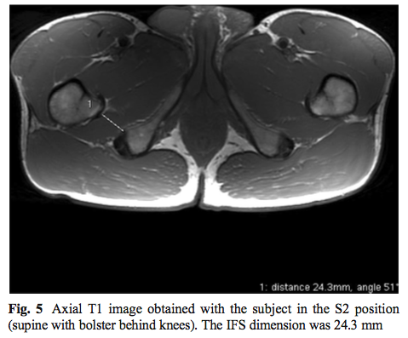
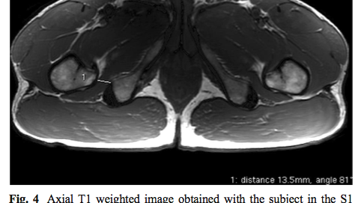
IFS measurement difference between S1 and S2 was 11.8mm (CI 9.9 to 13.7 mm, p<0.001)
Daily IGRT only allows reduction of 5-10mm from 15 mm PTV
Allen Li et al., Pract Radiat Oncol. 2016 Jul-Aug; 6(4): e135–e140
Notes:
That difference is greater than the sum total distance gained with IGRT ( based on secondary analysis of RTOG 0630 – need 1.5cm CTV to PTV expansion to account for day to day variation)

Slide 28
A brief note on image registration
AAPM TG-132 (2017) describes image registration, fusion algorithms and techniques
Potential exists for deformable registration techniques, but with increased degrees of freedom, there is increased potential for error
At present, routine registrations are rigid
Brock, et al. Use of image registration and fusion algorithms and techniques in radiotherapy: Report of the AAPM Radiation Therapy Committee Task Group No. 132

Slide 29
Registration methods
Brock, et al. Use of image registration and fusion algorithms and techniques in radiotherapy: Report of the AAPM Radiation Therapy Committee Task Group No. 132

Slide 30
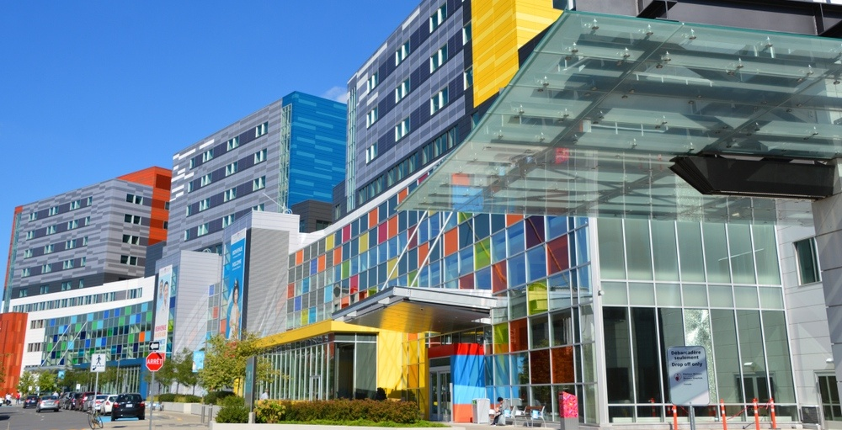
Fellowship Project
Notes:
LC0036932
RV5498832

Slide 31
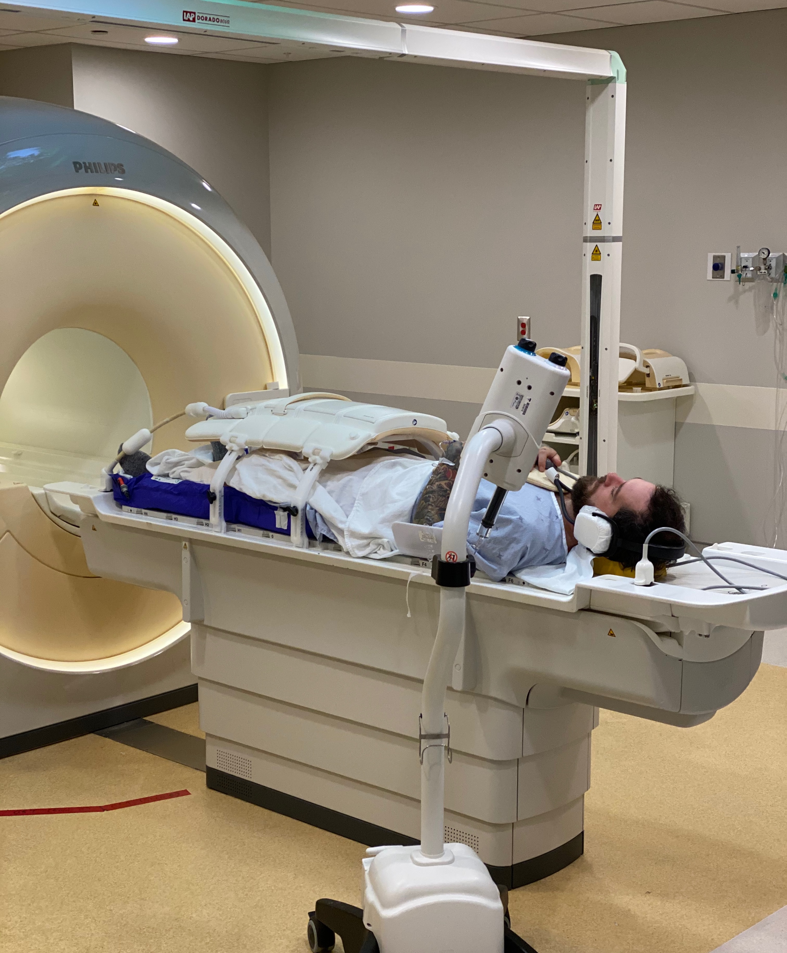
Extremity MRI Simulation

Slide 32
Hypothesis
More precise CTV delineation can be created with the use of MRI simulation
This in turn should be result in reduced toxicity for patients without reduction in local control
Notes:
Newer technology and has its challenges, so not as well described in literature
Objective of my work was to work with Ives, Sim Techs to help introduce the implementation here at MUHC

Slide 33
Project: Implementing MRI Sim for Sarcoma at MUHC
Primary objective is to develop set of protocols and experience for extremity sarcoma
Diagnostic MRI protocols exist for extremities and other anatomical areas where sarcomas arise, however
Cannot translate diagnostic protocols to treatment protocols 1:1 as there are limitations on both the MRI acquisition and treatment delivery

Slide 34
Image Acquisition
CT Sim is done first (45min)
+- bolus as needed (usually wet towel)
No contrast at this step
Skin markers for incisions, biopsy sites, drains as needed
Vac loc for most cases
MRI Sim is done second (45min, usually same day)
Patient placed in same positioning on MR Sim bed
Commercial skin markers used as above
Receiver coils placed over anatomical site of interest
Scans acquired with IV contrast (gadolinium)

Slide 35
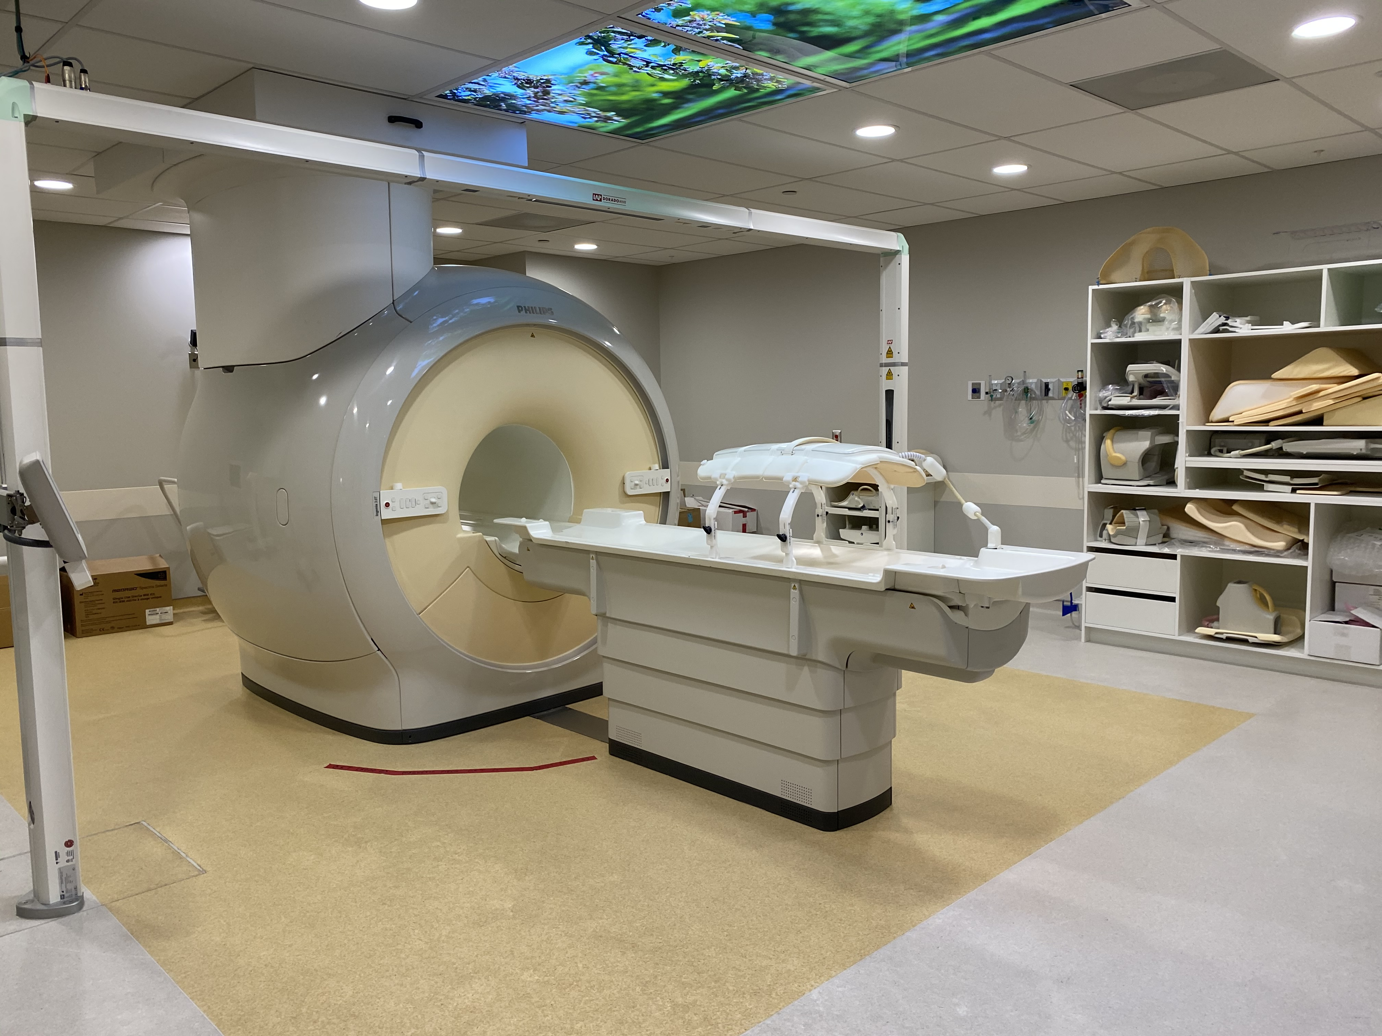
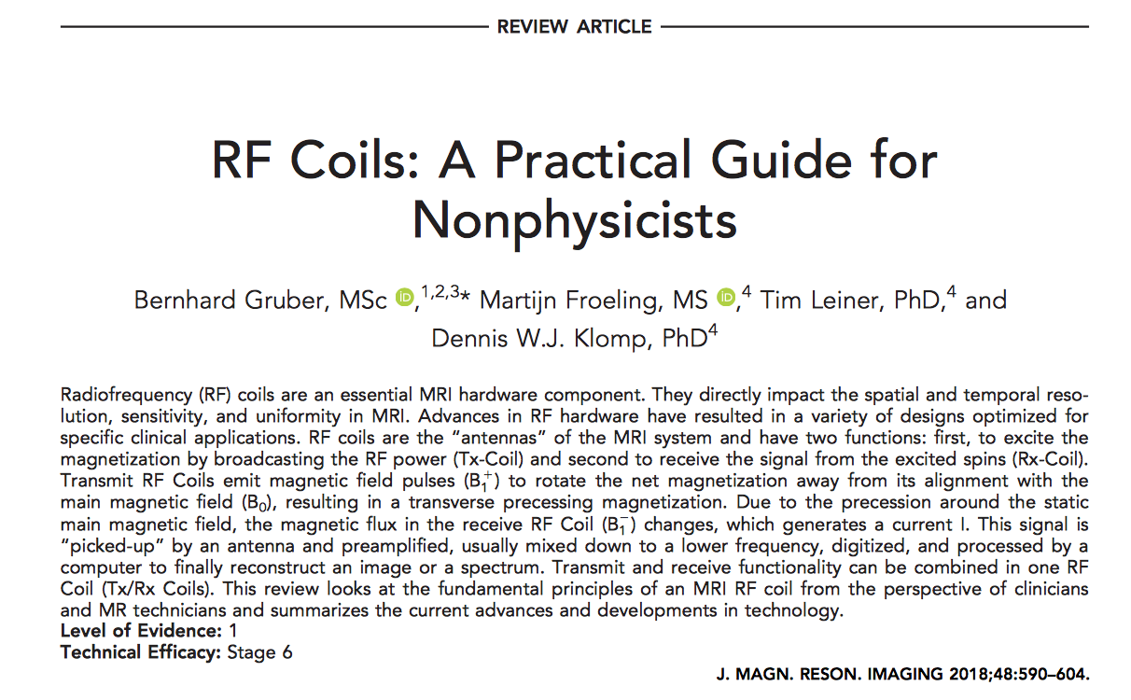
Receiver Coil
High RF sensitivity over a small region of interest
Placed over the anatomy of interest

Slide 36
MRI Sequences
Scout scan done first with low fidelity to plan simulation scans
Verifies treatment position
Verifies image quality with receiver coils
Delineate limits for field of view, orientation of scan, motion artifact, and shim
Parameters are selected so each scan is no longer than about 7 min
This depends on slice thickness, if there are limitations on energy deposition due to surgical hardware, stents, etc.
3 scans acquired
Axial T2 fat saturated
Axial T1 + contrast
Coronal T2 fat saturated
Notes:
Found coronals more helpful than sagitals. The eclipse upgrade does enable contouring on sagittal and coronal views, so from a workflow perspective that may change in the future, but for now, this is what we’ve found to be most helpful

Slide 37
Sample MRI Parameter Card
Notes:
Describes what is needed for scan parameters
Shim…
These are defined for our MRI sims

Slide 38
Logistical Considerations
Can’t really do ‘add-ons’
Need:
MRI consent
Verification of any MR compatible hardware, stents, etc.
MRI sim staff available
MRI sim time available
Many sarcoma consults were from outside Montreal, so lead time can limit ability for distant patients to arrange, as opposed to a same day add-on CT Sim
Largest barrier to access to date

Slide 39
Sarcoma Sites Imaged
Lower extremity
Thigh
Knee
Calf
Pelvic
Iliac crest
Vulvar
Forearm
Cervical spine

Slide 40
Challenges with MRI Sim
Both technical and logistical
Sarcoma also difficult from treatment planning and delivery perspective even without added complexity of MRI simulation

Slide 41
MRI Technical Challenges
Patient positioning in MRI limited from bore size, restriction of receiver coil
Field of View (FoV) limit in MRI due to limitations of shim, receiver coils, and scan lengths
Large FoV scans will require:
Two sets of images (eg inferior and superior)
~Twice the MRI time to acquire
Other protocols working around this limitation were a work in progress
For best image acquisition, target should be as closest to centre of bore as possible
This is DIFFERENT than vast majority of treatment positions, hence the challenge

Slide 42
MRI Technical Challenges
Chest wall lesions have respiratory motion
Upper extremity lesions have no good obvious way to position in centre of magnet that is also treatable

Slide 43
Treatment Challenges
Limited on leg positioning due to limitations of MRI
Potential of increasing dose by proximity to contralateral limb
May limit how bolus is positioned, but usually this is flexible

Slide 44
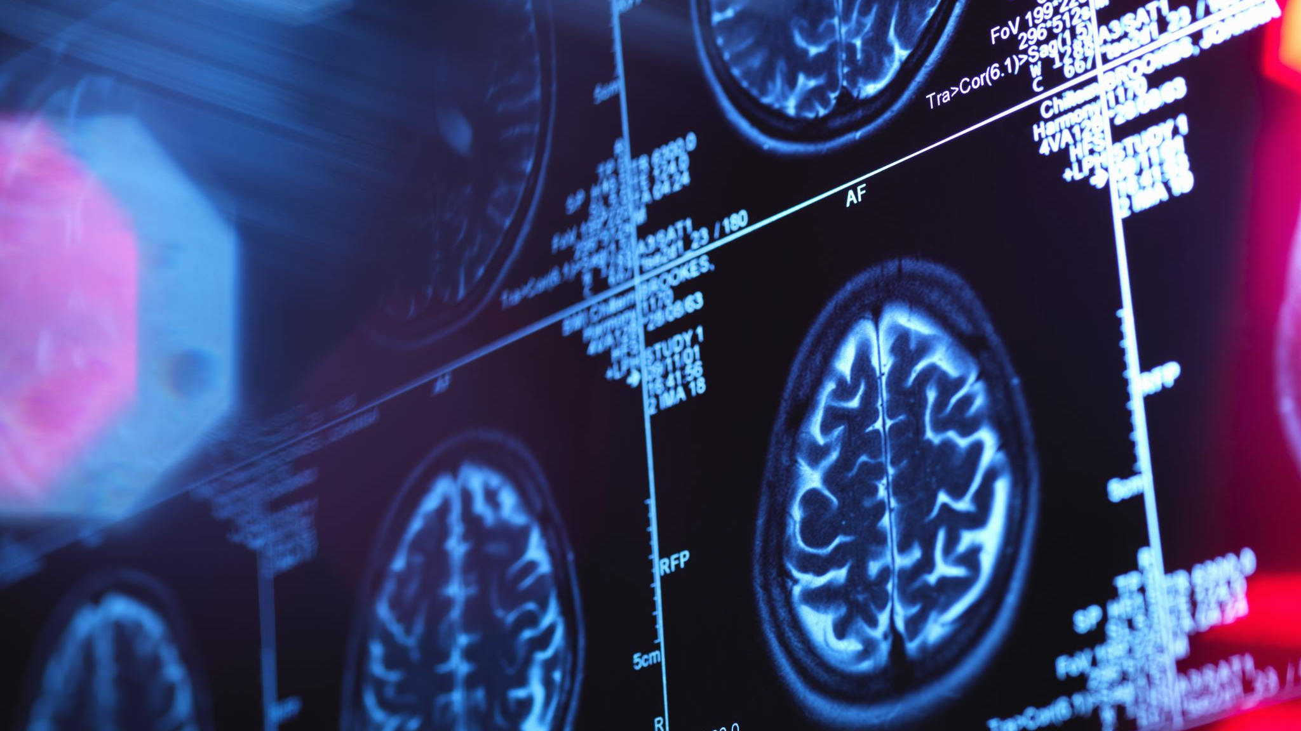
MRI Simulator Sarcoma Cases

Slide 45
Demographics
10 patients, 12 plans
5 lower extremity
2 upper extremity
2 pelvis
1 spine

Slide 46
Cases Performed
Intent
Preoperative | 7
Postoperative | 1
Oligomet | 1
Palliative | 1
Location
Leg | 5
Arm | 2
Pelvis | 2
Spine | 1
Histology
Myxofibrosarcoma | 3
Undifferentiated pleiomorphic sarcoma | 2
Leiomyosarcoma | 1
Liposarcoma | 2
Epithelioid | 1
Ewing Sarcoma | 1

Slide 47
Preoperative RT: High Grade Myxoid/Round Cell Liposarcoma
Notes:
Patient underwent MRI simulation, Contour shows gross tumor + surrounding edematous changes

Slide 48
Preoperative RT: High Grade Myxoid/Round Cell Liposarcoma
Notes:
Patient underwent MRI simulation, Contour shows gross tumor + surrounding edematous changes

Slide 49
Importance of Recent MRI
Notes:
Diagnostic MRI performed September 13

Slide 50
Importance of Recent MRI
Notes:
Diagnostic MRI performed September 13

Slide 51
Preoperative RT Post Unplanned Excision: High Grade Myxofibrosarcoma

Slide 52
Preoperative RT Post Unplanned Excision: High Grade Myxofibrosarcoma

Slide 53
Preoperative RT Post Unplanned Excision: High Grade Myxofibrosarcoma
Notes:
This is the diagnostic MRI - > even with fusion, compared to sim -> off by ~1.5cm root mean distance from centroid!
Note change in body surface anatomy as well

Slide 54
Preoperative RT Post Unplanned Excision: High Grade Myxofibrosarcoma
Notes:
Can see mismatch in thorax well – required separate position for upper extremity MR sim -> was not perfect fusion

Slide 55
Preoperative RT Post Unplanned Excision: Vulvar Epithelioid Sarcoma

Slide 56
Preoperative RT Post Unplanned Excision: Vulvar Epithelioid Sarcoma

Slide 57
SBRT for Oligometastatic Leiomyosarcoma
Notes:
Lesion was picked up on followup PET. NOT seen on CT Sim, OR CT component of PET.
Can you identify the lesion?

Slide 58
SBRT for Oligometastatic Leiomyosarcoma
Notes:
Lesion was picked up on followup PET. NOT seen on CT Sim, OR CT component of PET.
In crosshairs, outlined in blue. Not visible otherwise!!
Note AP direction of motion artifact due to bowel- would have been helpful to give buscopan in this case, however, still worked

Slide 59
SBRT for Oligometastatic Leiomyosarcoma
Notes:
Same case… retrospectively had bone lesion as well identified on diagnostic MRI done for other purpose, week after MR sim was done. Not PET avid! However suspicious on MRI. Well, luckily enough we see it here. Again, not obvious on CT but in retrospect visible

Slide 60
SBRT for Oligometastatic Leiomyosarcoma
Notes:
Here is the MRI Sim image

Slide 61
SBRT for Ewing Sarcoma
Notes:
9 year old female with ewing sarcoma, retreatment at sensitive site. MRI used for accuracy

Slide 62
SBRT for Ewing Sarcoma
Notes:
MRI spine not new per say but successful

Slide 63
Results
Notes:
Overall mean differences were low. Large variance

Slide 64
Results

Slide 65
Results
Notes:
Overall a high degree of overlaps. Overlaps become less significant with larger PTVs.

Slide 66
Results
Largest differences in Sørensen-Dice coefficients were observed in upper extremities and hips
Sørensen-Dice coefficients were also low in SBRT plans due to low absolute treatment volumes

Slide 67
Conclusions
Extremity STS has a wide anatomical variation from diagnostic imaging to treatment position
MRI simulation may help reduce registration errors and aid in defining GTV and CTV in extremity soft tissue sarcoma
This may help in turn reduce treatment volumes and patient toxicity
MRI simulation allows for routine lower extremities fusions
Upper extremities have their own challenges and will need team based approach

Slide 68
‘Modified Eiber Protocol’

