Slide 1

Nodal Target Volumes
Breast RO Research Day
October 14, 2020
Dr Jordan Stosky, MD, FRCPC

Slide 2
Objectives
Present TRONE nodal target review
02
Review RTOG, ESTRO, and RadCOMP atlases
01
Discuss practice at TBCC
03

Slide 3
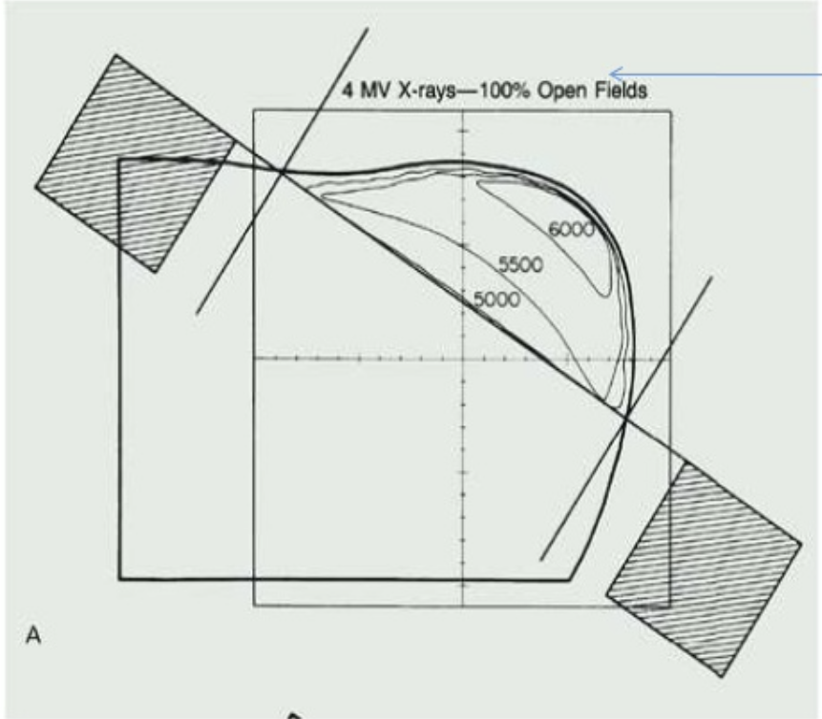
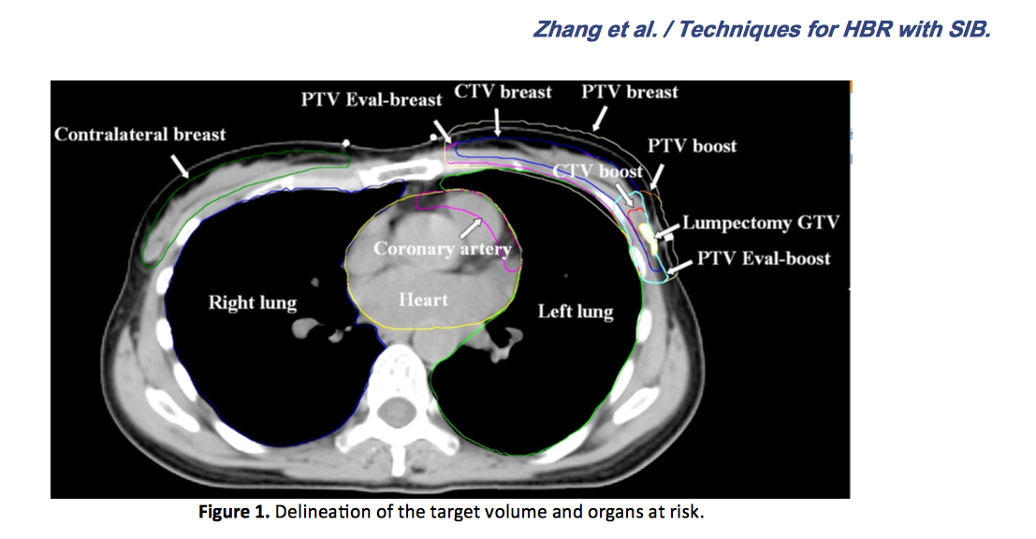

Slide 4
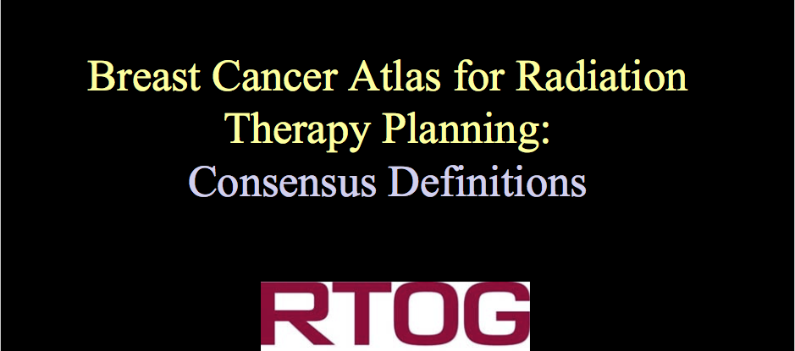
2008
Notes:
Designed for early stage and locally advanced cases

Slide 5
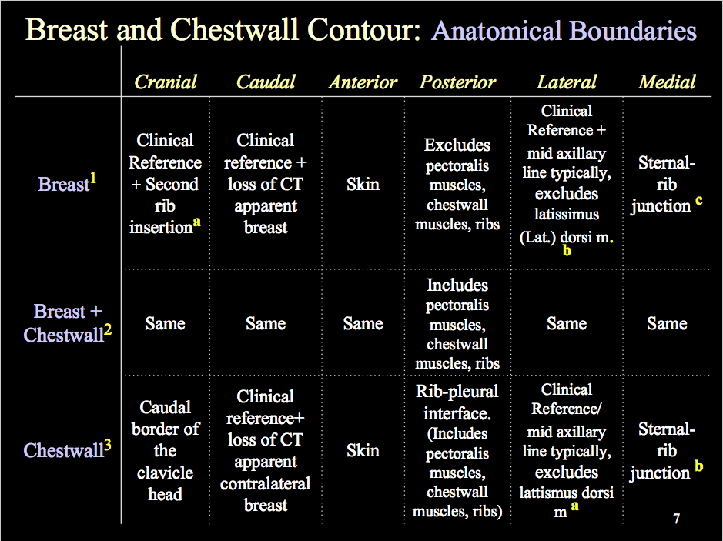

Slide 6
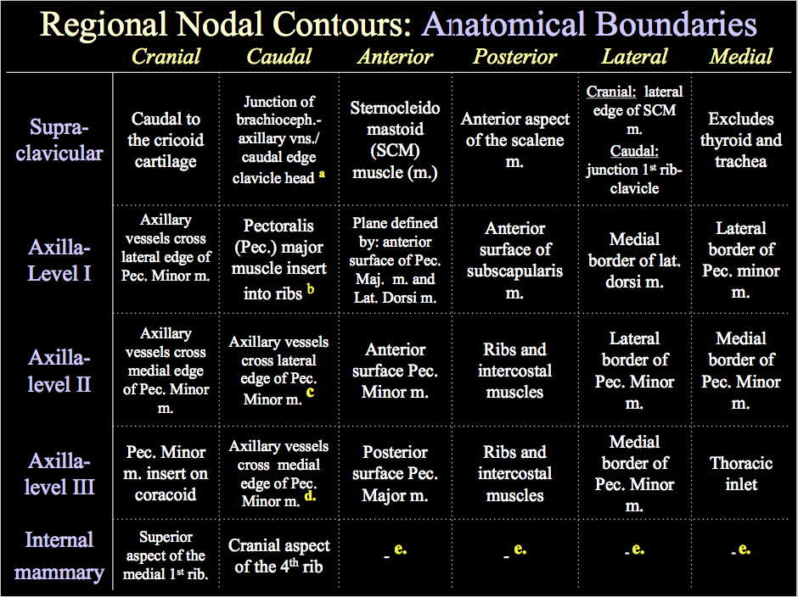

Slide 7
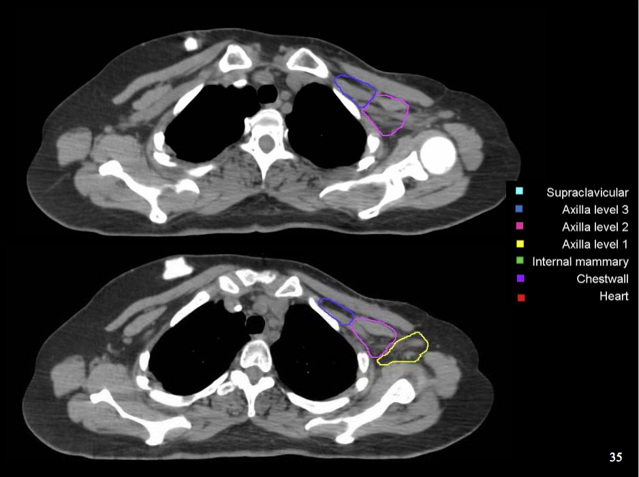

Slide 8
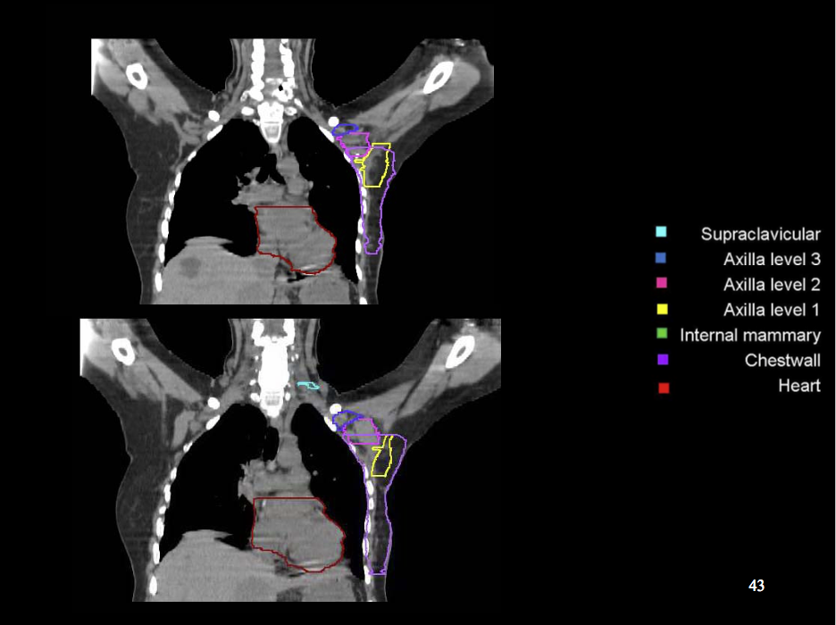

Slide 9
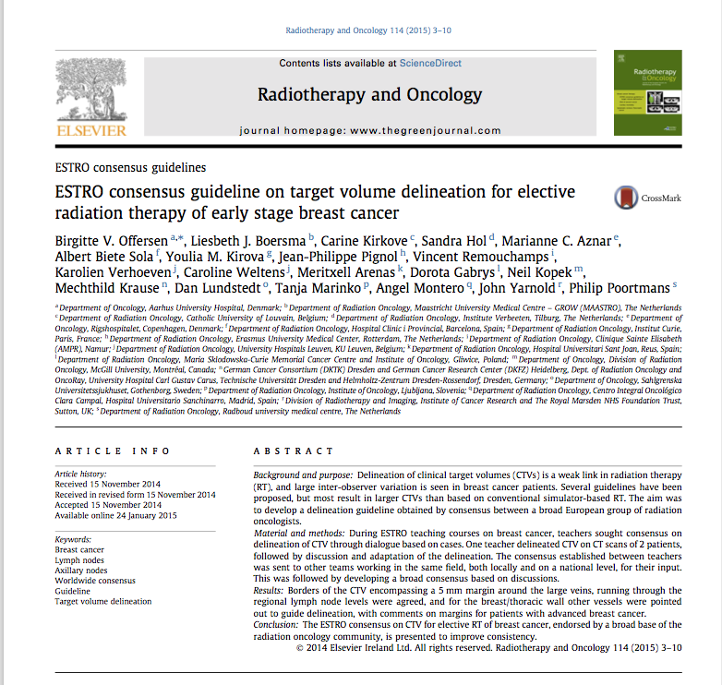
2015
Notes:
Explicitly designed for early stage, to be adapted for locally advanced cases

Slide 10
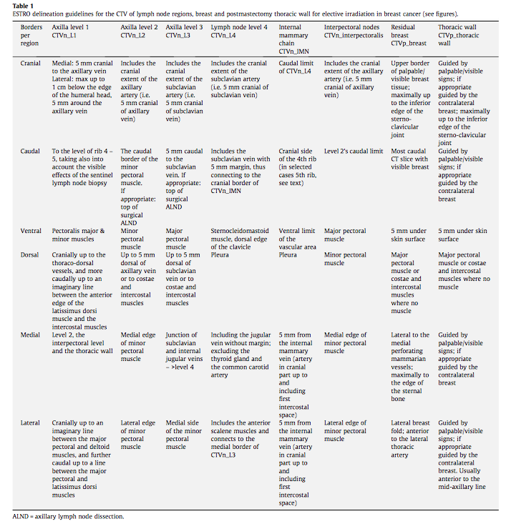

Slide 11
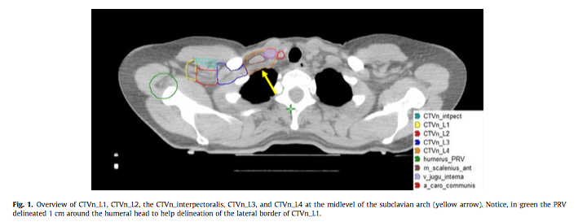

Slide 12
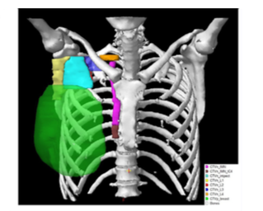

Slide 13
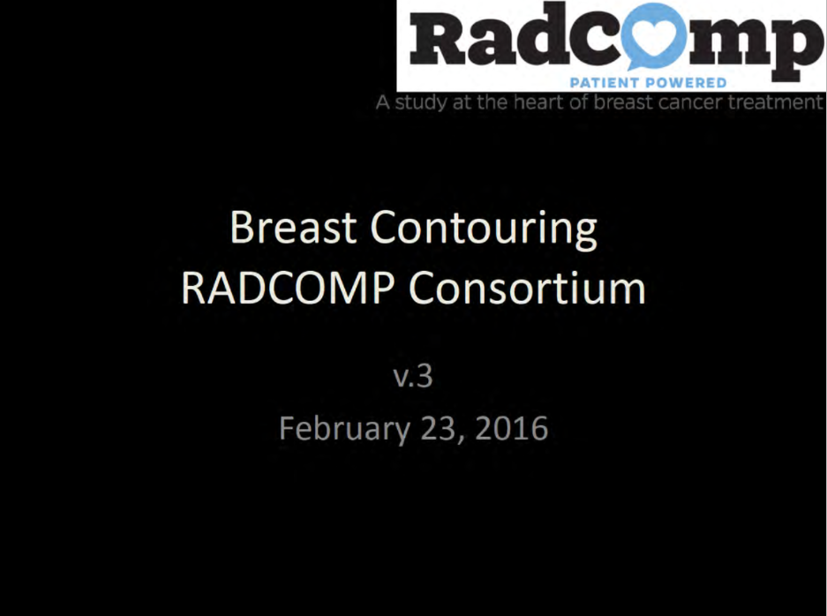
2016
Notes:
Developed for RTOG 3509/3510 – Randomized Phase III photon vs proton irradiation in breast cancer

Slide 14
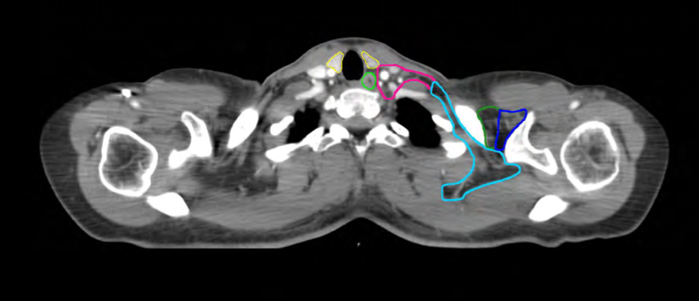
Notes:
Biggest addition/change is the inclusion of the posterior neck for those with high risk features

Slide 15
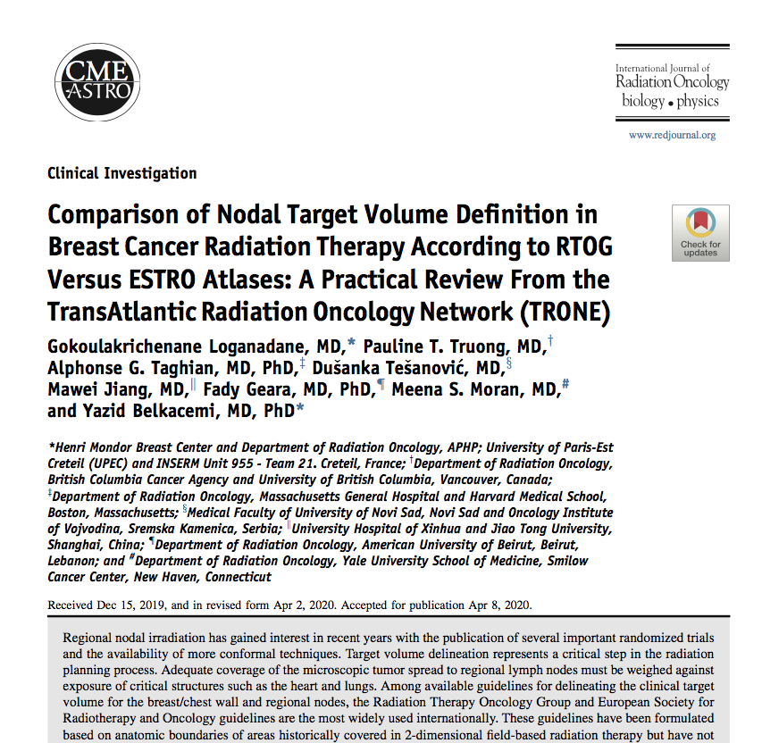
Compared anatomical boundaries of RTOG, ESTRO, and RADCOMP atlases
Systematic review of patterns of failure studies compared to published atlases

Slide 16
Anatomical Boundary Comparisons

Slide 17
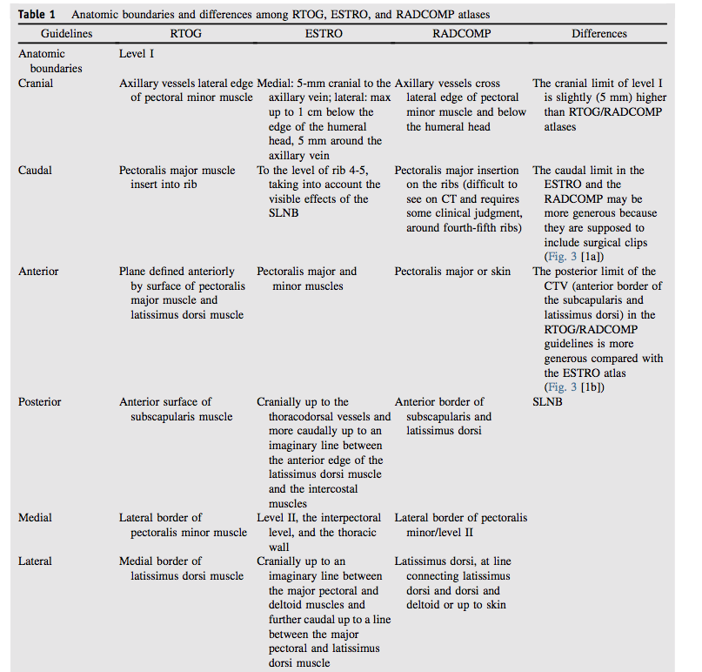
Boundary | Larger | Limited
Cranial | ESTRO (5mm) | RTOG RADCOMP
Caudal | ESTRO RADCOMP (includes clips) | RTOG
Posterior | RTOG RADCOMP | ESTRO
LEVEL I

Slide 18
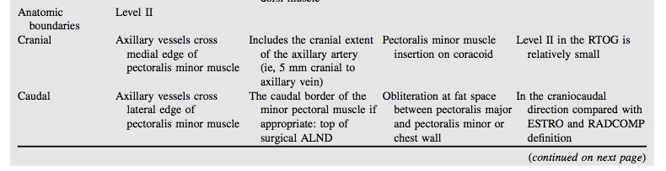
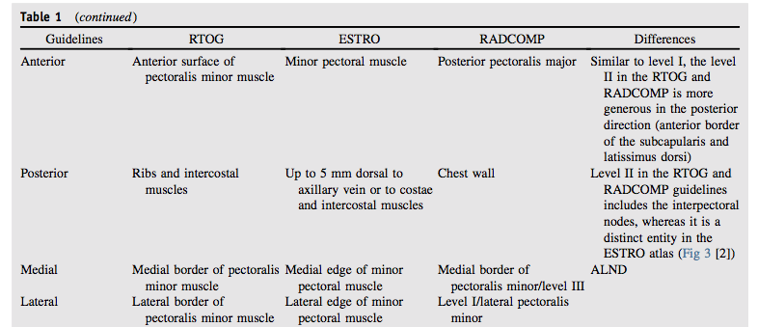
Boundary | Larger | Limited
Cranial Caudal | ESTRO RADCOMP | RTOG
Posterior | RTOG RADCOMP | ESTRO
Interpectoral | ESTRO (explicit) | ASTRO RADCOMP (not explicitly defined)
LEVEL II

Slide 19
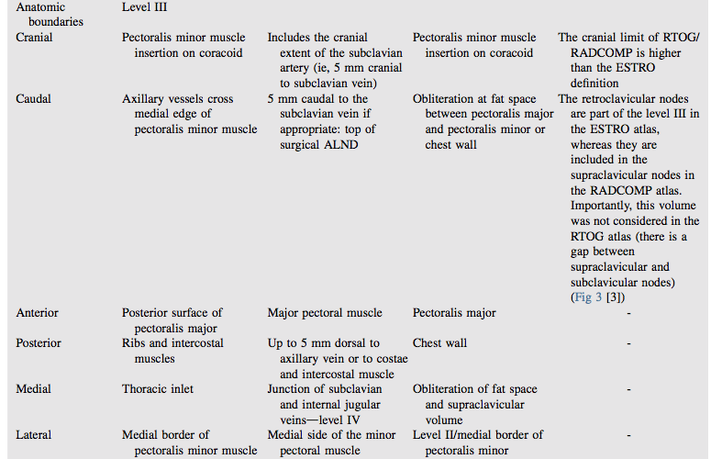
Boundary | Larger | Limited
Cranial | RTOG RADCOMP | ESTRO
Retroclavicular nodes | ESTRO (level III) RADCOMP (supraclavicular) | RTOG (not considered – gap present)
LEVEL III

Slide 20
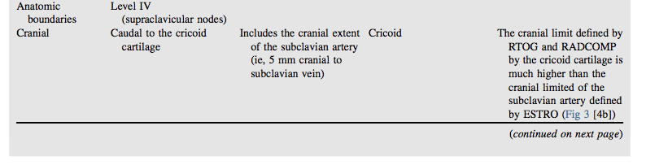
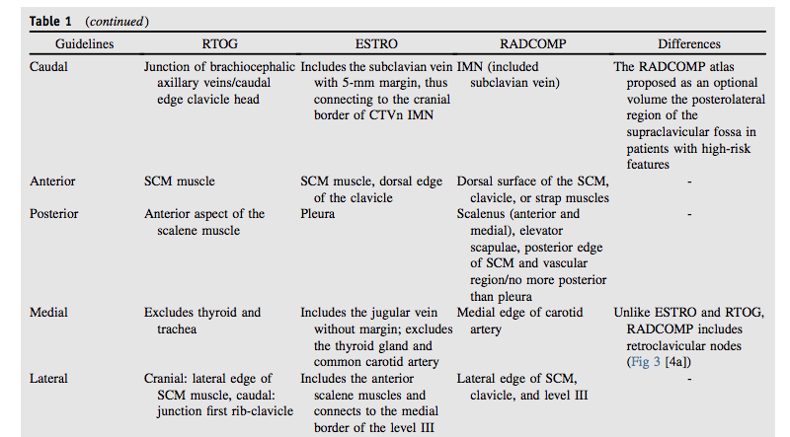
Boundary | Larger | Limited
Cranial | RTOG RADCOMP (cricoid cartilage) | ESTRO (subclavian artery)
Caudal | RADCOMP (optional posterolateral supraclav fossa) | RTOG ESTRO
Level IV

Slide 21
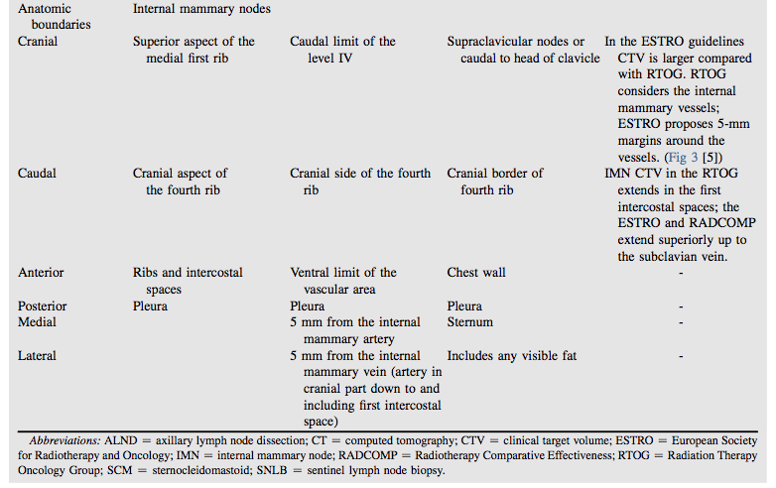
Boundary | Larger | Limited
Cranial | ESTRO RADCOMP (subclavian vein) | RTOG (first intercostal space)
Laterally | ESTRO (vessels +5mm) | RTOG (vessels)
IMNs

Slide 22
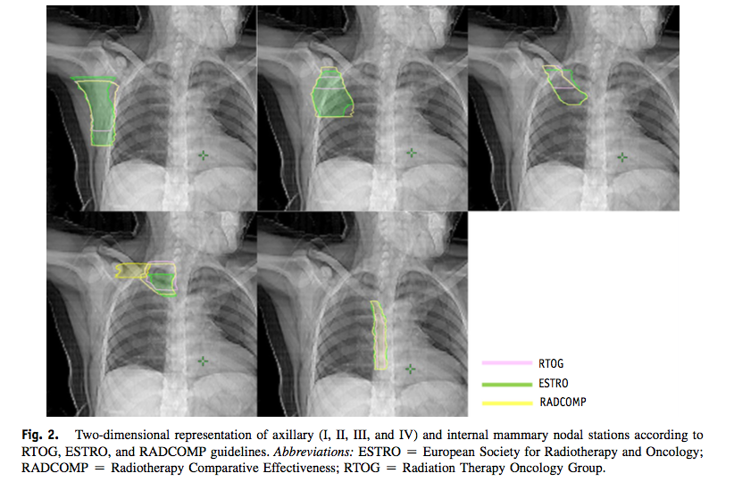

Slide 23
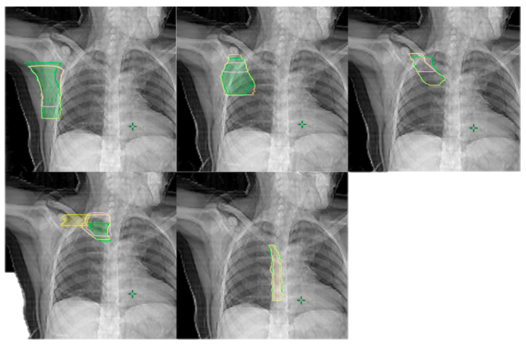

Slide 24
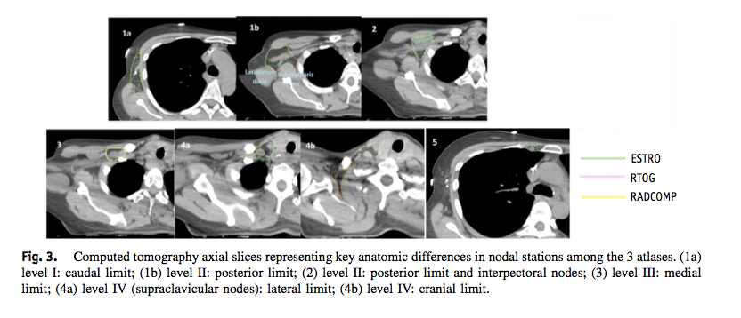

Slide 25
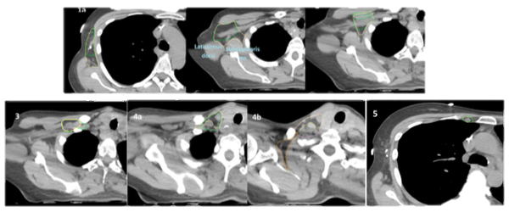
Notes:
Poor coloring in article – I’ve placed on a black background for easier viewing for posterity

Slide 26
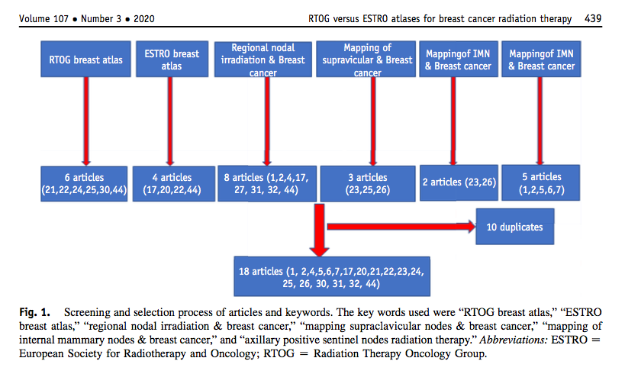
Pattern of failure study selection
Included were 18 papers from 2000 – 2020

Slide 27
Key points from article
Chang et al, 235 recurrences, 129 patients
  RTOG CTVs cover 96% of pT1-2 pN0-1 cases
  Early stage patient recurrences outside ESTRO and within RTOG were 4% among patients with early stage disease
Borm et al, MA.20, EORTC, AMAROS, and Z0011 dose analysis
  No treatment plan designs covered full dose to nodes
  smaller nodal CTVs in low risk patients justified
Notes:
ESTRO not suitable for early stage disease

Slide 28
Key points from article
Multi-institution Korean study, 337 recurrences, 234 patients
  9% of supraclavicular failures were cranial to subclavian artery
  20% of supraclavicular failures posterolateraly to ant scalene
  ESTRO had 28% geographic miss in T3-T4 and N2-N3 disease
Chang et al,
  29% of nodes would have been additionally covered with RTOG as compared to ESTRO atlas
    Compared to 7% of outside ESTRO and within RTOG recurrences
Notes:
ESTRO not suitable for early stage disease

Slide 29
Key points from article
Borm et al., 580 FDG-positive nodes
  RTOG less geographic miss compared to ESTRO (14 vs 21%)
Loganadane et al., Post-mastectomy mapping series,15 recurrences
  13% occurred outside ESTRO but within RTOG volumes
Notes:
ESTRO not suitable for early stage disease

Slide 30
Conclusions 1
Both ESTRO and RTOG atlases suitable for low risk disease
RTOG guidelines appear more applicable for locally advanced disease and post mastectomy

Slide 31
Areas not covered by RTOG or ESTRO
Posterolateral supraclavicular region aka POSTERIOR TRIANGLE
SCV nodes above cricoid cartilage

Slide 32
Posterior triangle recurrences
Chang et al,
  26% of recurrent lesions
  37% of locoregional recurrences
  Larger number of nodes (1 vs 2 vs 3+) associated with higher risk of posterolateral involvement (7 vs 13 vs 56%, p=0.003)
  Young age (<45), triple negative associated with outside ESTRO volume recurrence
DeSelm et al.,
  Majority of out-of-field recurrences occur in post triangle
  Outside RTOG in 67%
  Outside ESTRO in 89%
  Authors advocated for larger CTV to include lateral SCV nodes with G3 and LVI
Notes:
ESTRO not suitable for early stage disease

Slide 33
Superior region of SVC nodes above cricoid cartilage
Chang et al,
  5% of regional recurrences located above traditional field
Regional recurrences in SVC increases with pN stage, suggesting insufficient coverage (multiple citations given in study)
Notes:
Also note our neck recurrences lately…

Slide 34
Conclusions 2
We should be paying closer attention to posterior triangle coverage, and deliberately covering in high risk patients
  G3, LVI, <45, triple negative, T3+, N2+
We should be considering having a more cranial nodal border above the cricoid in high risk patients

Slide 35
What about the IMNs?
Jethwa et al
  Vessels+0mm – 53% coverage.
  Vessels +5mm – 93% coverage
  First 3 intercostal spaces – 78% coverage
  4th and 5th intercostal space – 14% coverage
  Above first intercostal space – 8%

Slide 36
Other circumstances
Gentile at al.,
  RTOG may be too limited in axilla for NAC, incomplete dissection, or IMRT

Slide 37
2020

Slide 38
Which is more suitable?
Low risk women – want sparse coverage to limit side effects
High risk women – cover more to avoid geographic miss
Special cases – extend CTV into areas at higher risk which would otherwise not be covered in RTOG, ESTRO atlases

Slide 39
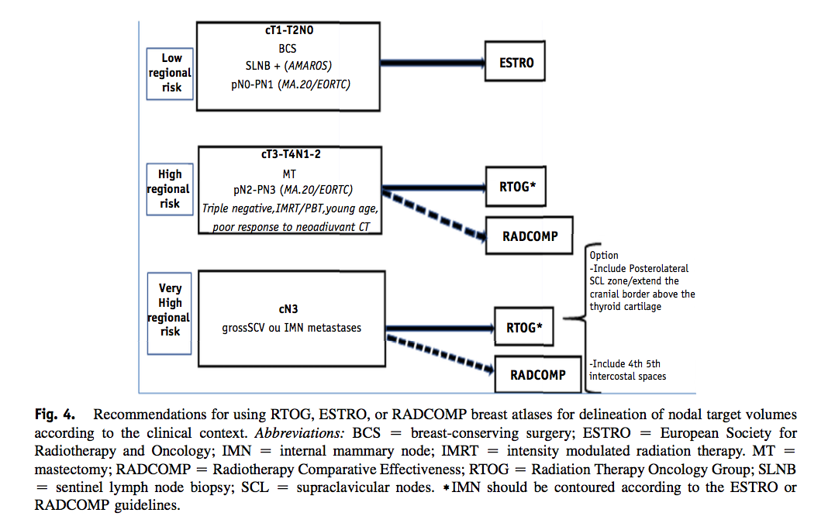

Slide 40
Low Regional Risk – cT1-T2N0
Both RTOG and ESTRO covered acceptably well
ESTRO chosen as had lower thyroid dose compared to RTOG <3 Gy vs 9 Gy in low regional risk

Slide 41
High Regional Risk – cT3-T4N1-2
RTOG undercovered IMNs, should contour by ESTRO method (+5mm)
Select patients with adverse features should consider RADCOMP
IMRT patients, triple negative, poor response to NAC, <45 years

Slide 42
Very High Regional Risk – cN3
Consider including posterolateral SCL zone/posterior triangle
Consider extending border above cricoid cartilage
Consider including 4th, 5th intercostal spaces

Slide 43
Who I think this should apply to
Locally advanced cases
Does not apply to patients on clinical trial – obviously they should be treated as per the trial protocol
Would consider excluding <45 yo, triple negative, G3, and LVI from ‘short’ field cases, and pay close attention to their nodal coverage
IMRT
Recurrent cases

Slide 44
Outstanding questions
What dose coverage level is ‘adequate’?
Should we adopt more modifications
  And if so, for which patients?
Should we explore changing our planning for high risk cases?
  Changes in contouring methods for ROs?
  Changes in planning methods for dosimetry?
What are the toxicity consequences for changing volumes?

Slide 45
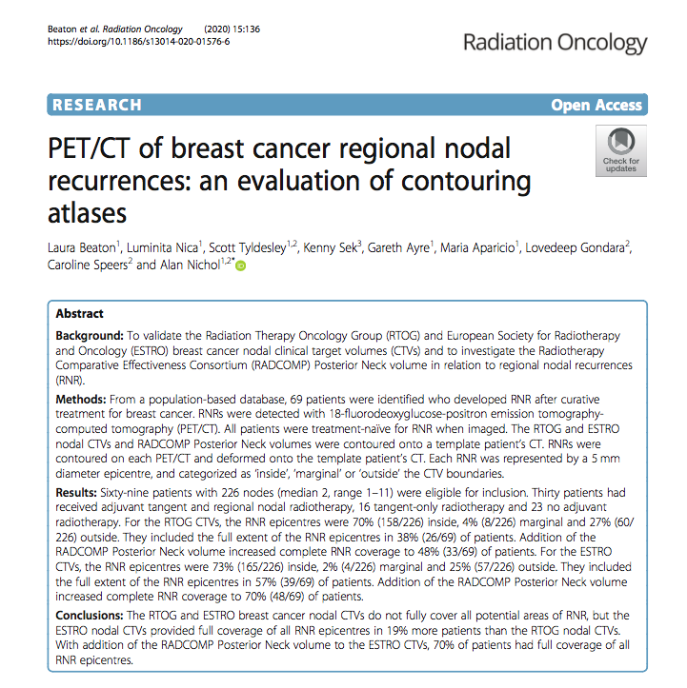
FDG-PET Recurrence Study
Notes:
BC – June 2020

Slide 46
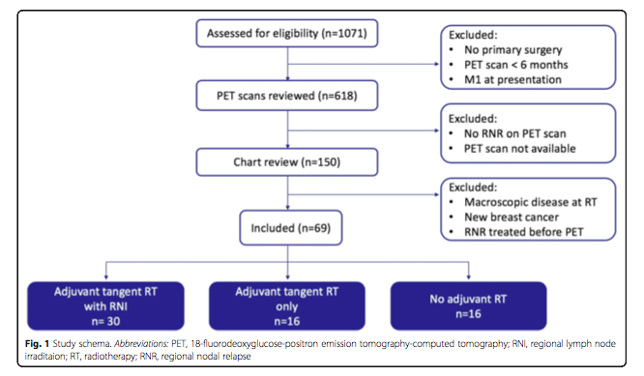
Methods
Identified 69 patients with 226 nodal regional nodal recurrences after curative treatment for breast cancer
PET staged and fused with deformable registration
Compared to RTOG, ESTRO, and RADCOMP atlases
Recurrences were classified as:
  Inside – entirely or mostly within CTV
  Marginal – mostly outside CTV edges
  Outside – completely outside CTV contours

Slide 47
Results
RTOG
  70% inside
  4% marginal
  27% outside
  Full extent – 38%
    Adding RADCOMP increased to 48%
ESTRO
  73% inside
  2% marginal
  25% outside
  Full extent – 57% of patients
    Adding RADCOMP increased to 70%

Slide 48
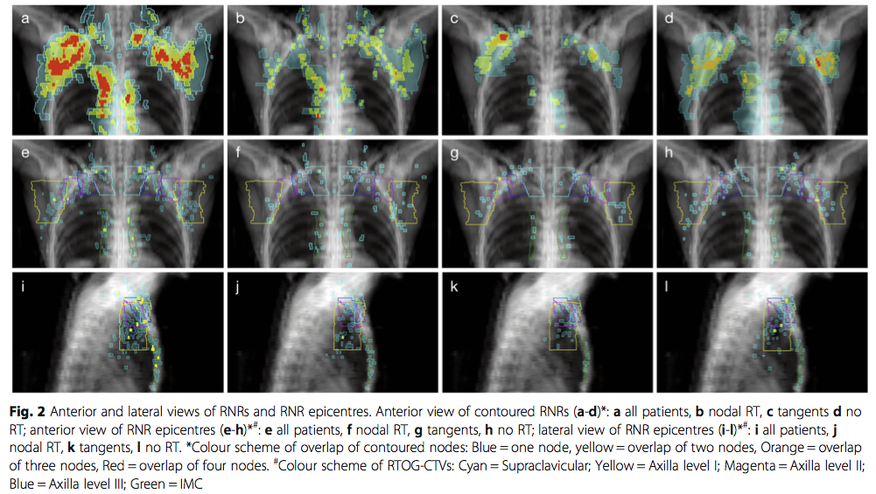

Slide 49
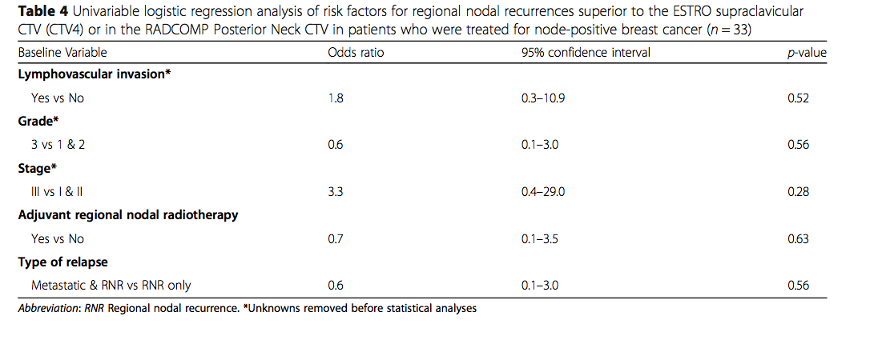

Slide 50
Study Conclusions
Trial authors suggest RADCOMP atlas be used in stage III patients

Slide 51
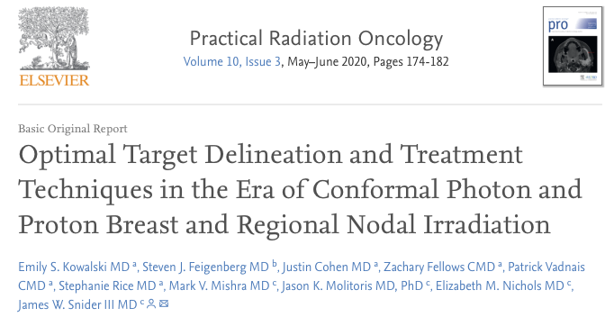
Comparing Planning Techniques – FDG Nodes
3D- CRT – 97% coverage
ESTRO VMAT – 89% coverage
RTOG VMAT – 93% coverage
RADCOMP VMAT – 98% coverage

Slide 52
A Note on Supraclavicular Recurrences

Slide 53
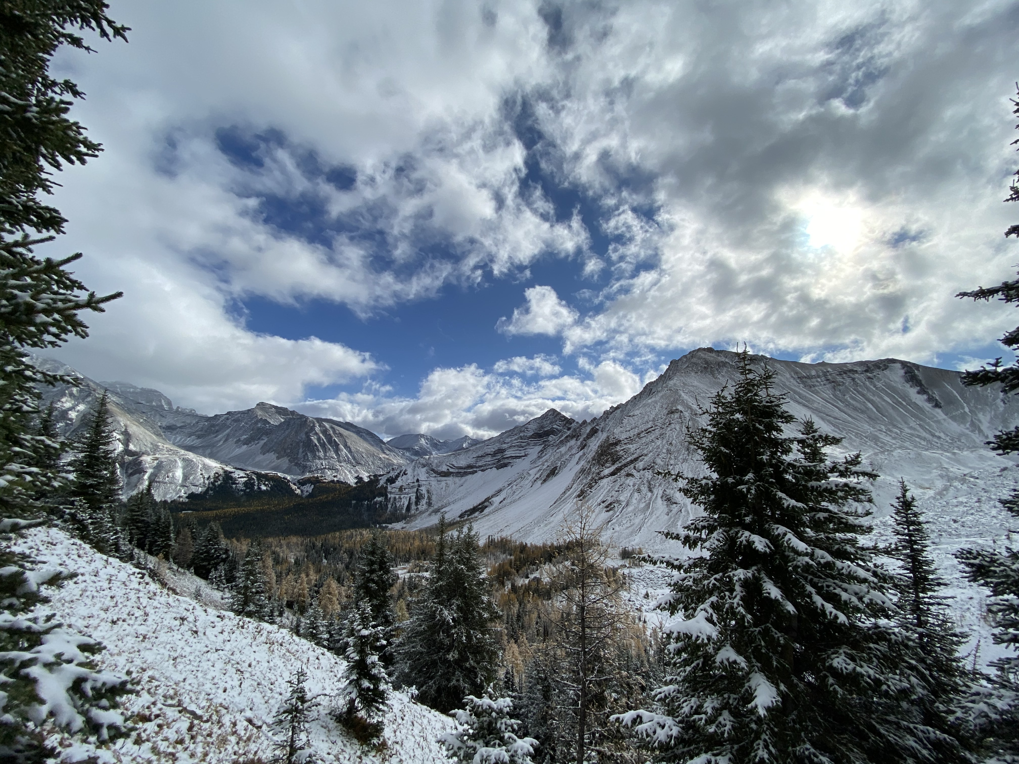
Fini

Slide 54
Areas for future discussion
Dropping IMN coverage for heart dose – does the benefit outweigh the risk?
Heart anatomy, doses, and contouring

